Slide 1


Causally Regularized Machine learning
Peng Cui, Tsinghua University
Kun Kuang, Tsinghua University
Bo Li, Tsinghua University

Slide 2
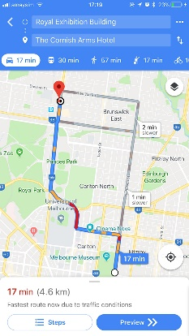
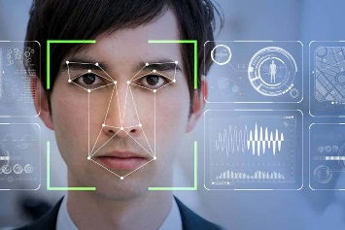
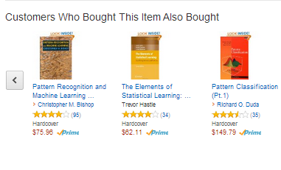

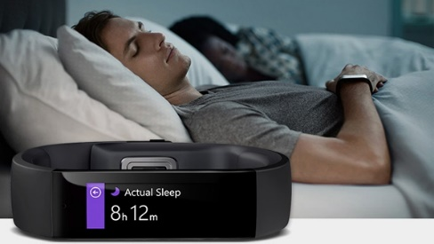
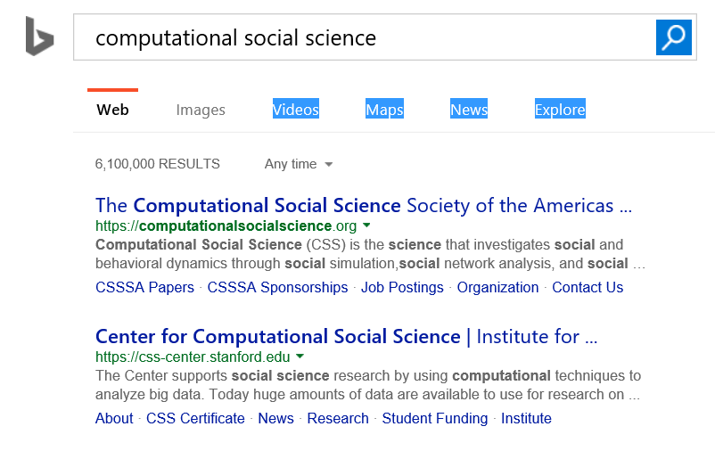

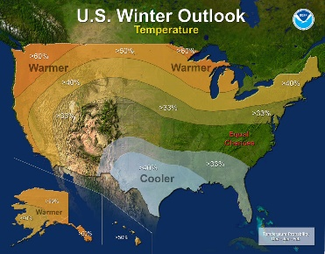
Predictive systems are impacting our life
A day in our life with predictive analytics
8:00 am
10:00 am
6:00 pm
8:30 am
4:00 pm
8:00 pm
Notes:
https://www.themsphub.com/a-day-in-your-life-with-predictive-analytics/
Predict sleep quality
Weather foreasting
Suggested route from home to workplace
Working: search
Buy a book
Diner recommendation
Movie recomendation

Slide 3
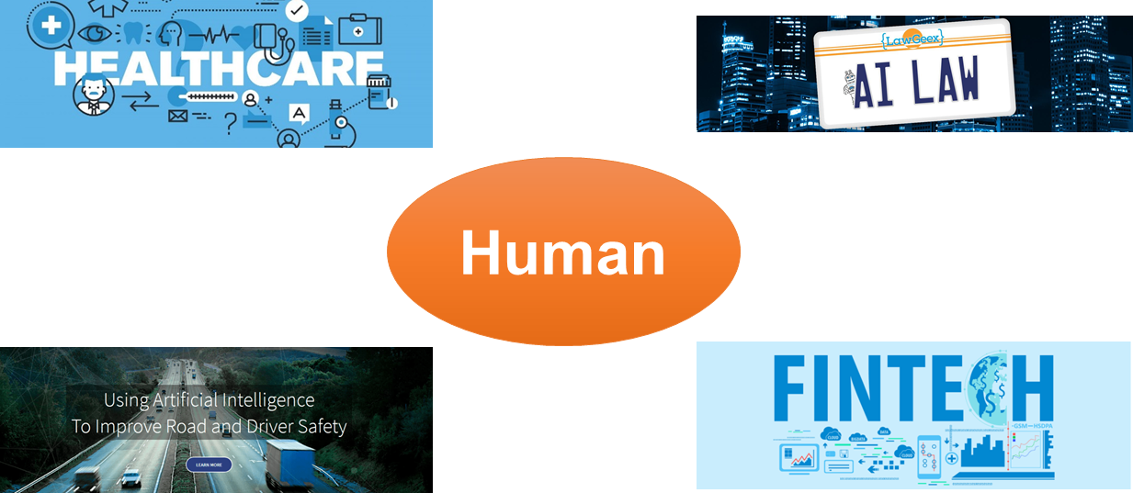
Even in risk-sensitive areas
Human’s risk-sensitive sense brings new challenges to today’s AI

Slide 4
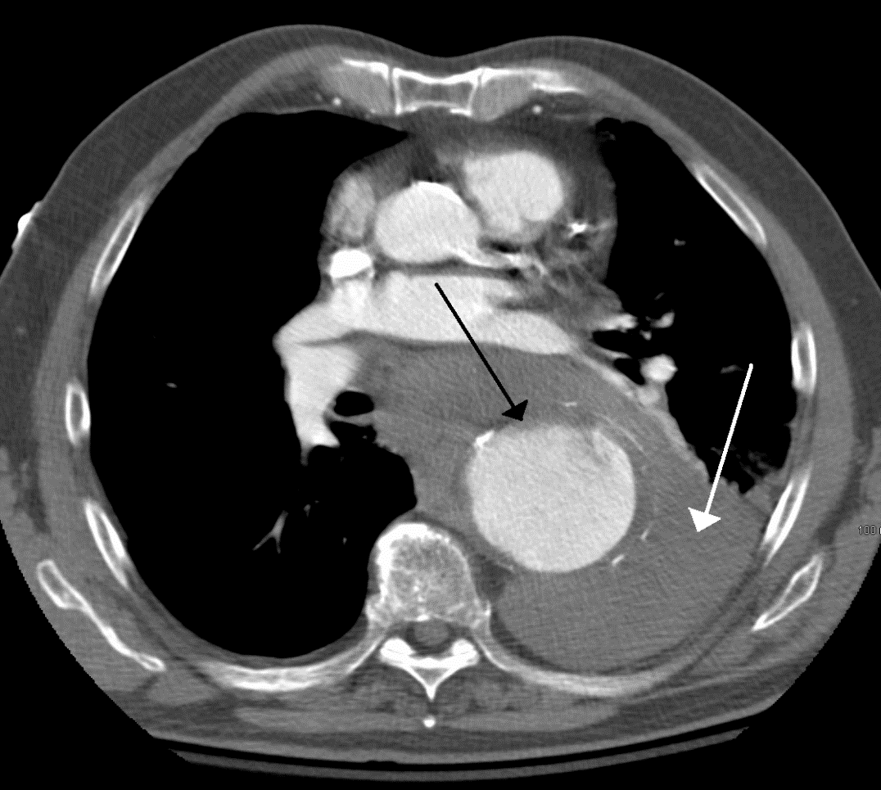

Explainability
Most machine learning models are black-box models
Unexplainable
Human in the loop
Health Military Finance Industry

Slide 5
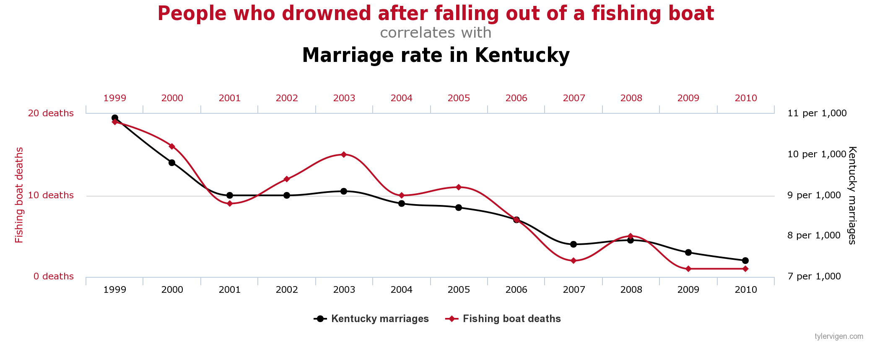
Explainability
Correlation is not explainable

Slide 6
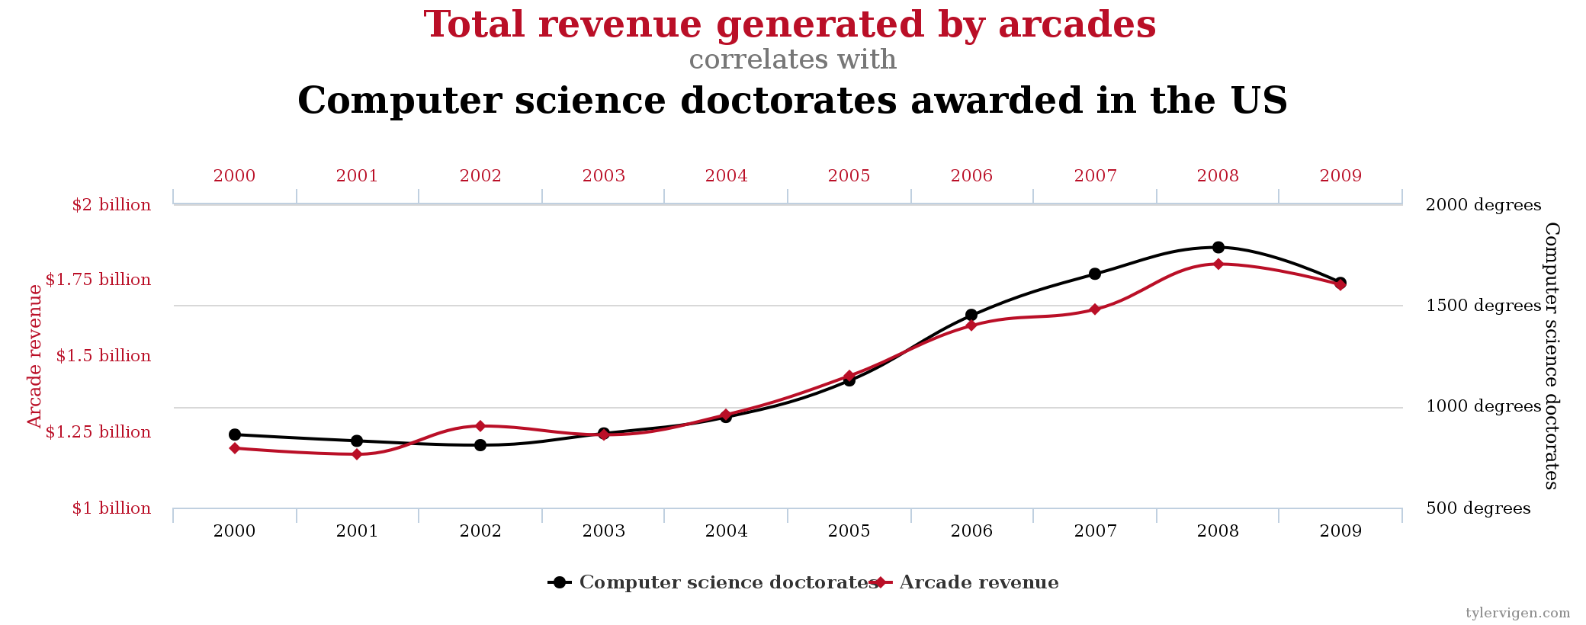
Explainability
Correlation is not explainable

Slide 7
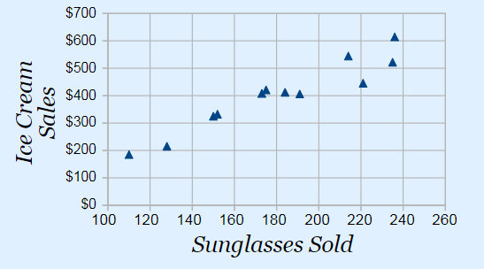
Explainability
Summer
Sunglasses Sold
Ice Cream Sales
Spurious Correlation !
Correlation does not imply causation!

Slide 8
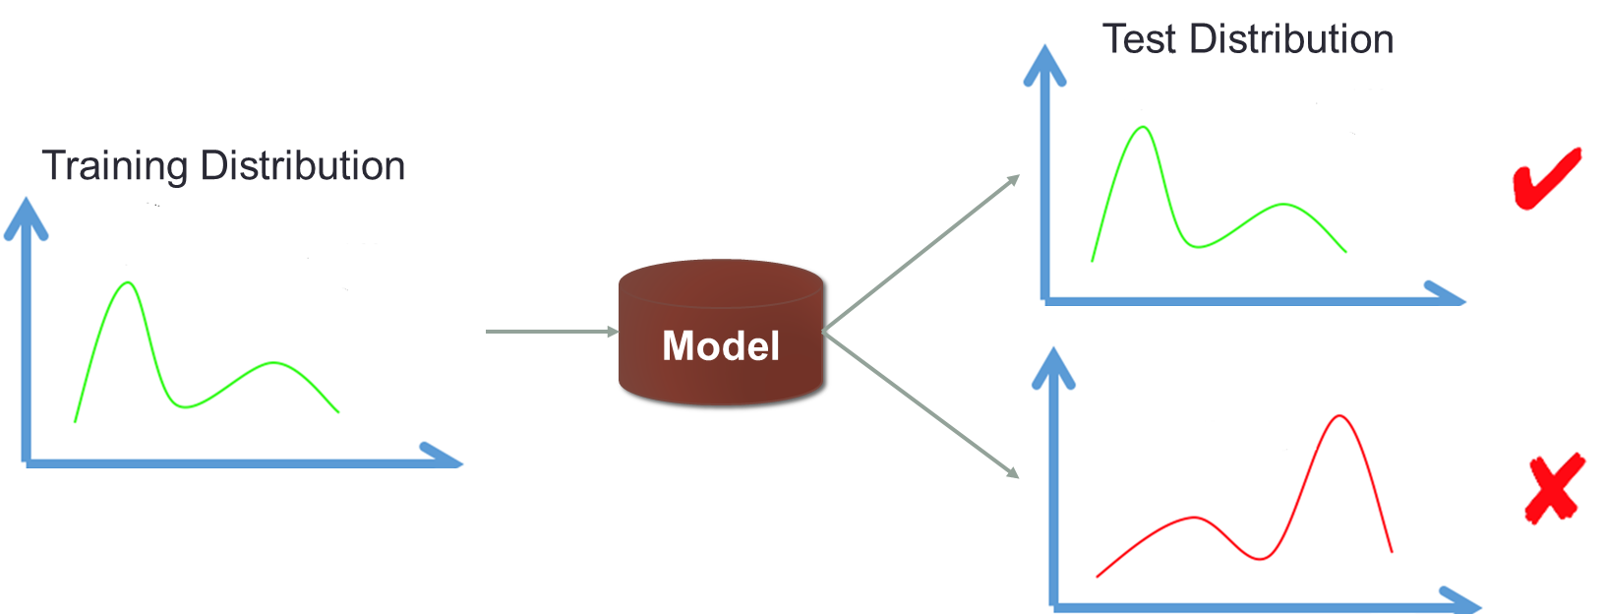
Stability
Most ML methods are developed under IID hypothesis

Slide 9


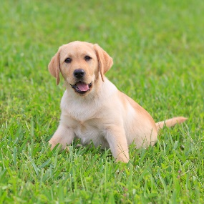


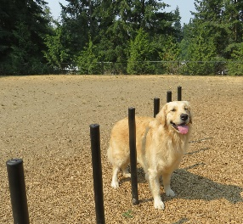


Stability
Yes
Maybe
No

Slide 10



Stability
Cancer survival rate prediction
Testing Data
Training Data
City Hospital
Predictive Model
City Hospital
Higher income, higher survival rate.
University Hospital
Survival rate is not so correlated with income.

Slide 11
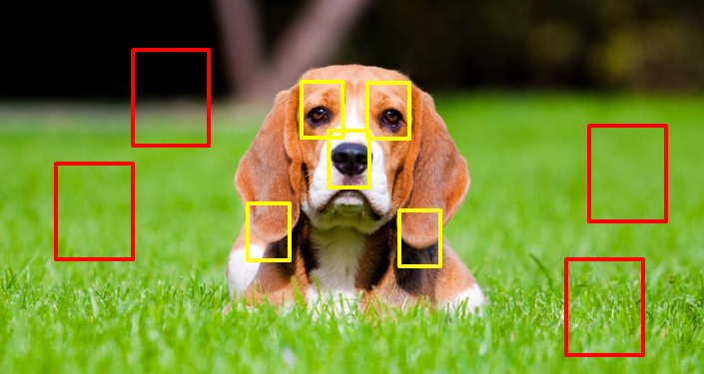
Stability
Correlation v.s. Causality

Slide 12

Actionability
Does predictive models guide decision making?
System changes algorithm from A to B at some point.
Is the new algorithm B better?
Say algorithm that provides promotion or discount link to a different customers
Algorithm A
Algorithm B

Slide 13

Actionability
Measure success rate (SR)
Old Algorithm (A) | New Algorithm (B)
50/1000 (5%) | 54/1000 (5.4%)
New algorithm increases overall success rate, so it is better?
 | Old Algorithm (A) | New Algorithm (B)
Low-income Users | 10/400 (2.5%) | 4/200 (2%)
High-income Users | 40/600 (6.6%) | 50/800 (6.2%)
Overall | 50/1000 (5%) | 54/1000 (5.4%)
Which is better?

Slide 14
Actionability
Income
Financial product offer
Accepted
Financial product offer
Accepted
Higher success rate due to
algorithm
Higher success rate due to
confounding bias
Decision making is a counterfactual problem, not a predictive problem!

Slide 15

Fairness

Slide 16
The source of these problems: Correlation
Correlation Framework
income—crime rate: Strong correlation
skin color—crime rate: Strong correlation
X
T
Y
T：skin color
X：income
Y：crime rate
Causal Framework
X
income—crime rate: Strong causation
skin color—crime rate: Weak causation
T
Y

Slide 17
Correlation V.S. Causation
Three sources of correlation:
Causation
Causal mechanism
Stable and Robust
Confounding
Ignoring X
Spurious Correlation
Sample Selection
Conditional on S
Spurious Correlation
T
Y
Summer
Ice Cream Sales
X
Income
T
Y
Financial product offer
Accepted
T
Y
Grass
Dog
S
Sample Selection

Slide 18
Correlation V.S. Causation
Three sources of correlation:
Causation
Causal mechanism
Stable and Robust
Confounding
Ignoring X
Spurious Correlation
Sample Selection
Conditional on S
Spurious Correlation
T
Y
Summer
Ice Cream Sales
X
Income
Can we recover causation from correlation?
T
Y
Financial product offer
Accepted
T
Y
Grass
Dog
S
Sample Selection

Slide 19
Why should we care about causality?
Recover causation for interpretability
Help to guide decision making
Make stable and robust prediction in the future
Prevent algorithmic bias

Slide 20
OUTLINE
PART I. Introduction to Causal Inference
PART II. Methods for Causal Inference
PART III. Causally Regularized Machine Learning
PART IV. Benchmark and Open Datasets
PART V. Conclusion and Discussion

Slide 21


Cause and Effect
Cause: The REASON why something happened
Effect: The RESULT of what happened
Questions of cause and effect:
Medicine: drug trials, effect of a drug
Social science: effect of a policy
Marketing: effect of a marketing strategy
…
What is causality?

Slide 22
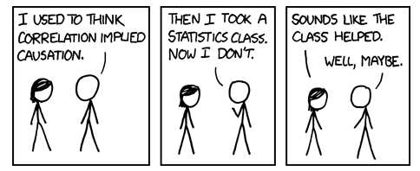
What is causality?

Slide 23
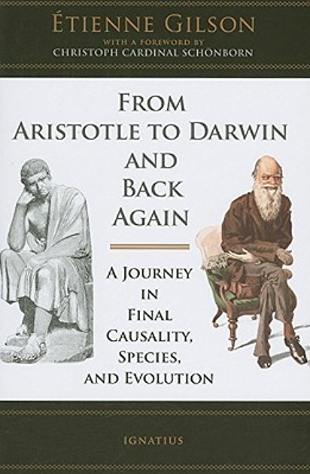



What is causality?
A big scholarly debate, from Aristotle to Russell

Slide 24
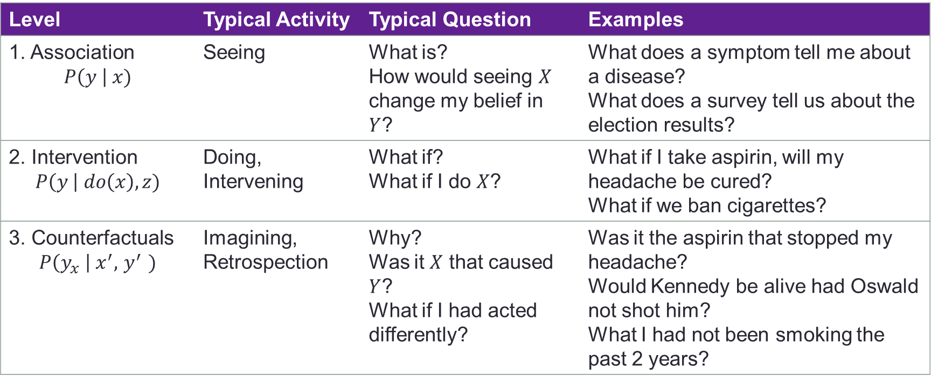
The Three Layer Causal Hierarchy
Level | Typical Activity | Typical Question | Examples
1. Association $$P\left(y \right| x)$$ | Seeing | What is? How would seeing $X$ change my belief in $Y$? | What does a symptom tell me about a disease? What does a survey tell us about the election results?
2. Intervention $$P\left(y \right| do\left(x\right), z)$$ | Doing, Intervening | What if? What if I do $X$? | What if I take aspirin, will my headache be cured? What if we ban cigarettes?
3. Counterfactuals $$P\left(y_{x} \right| x^{′}, { y}^{′} )$$ | Imagining, Retrospection | Why? Was it $X$ that caused $Y$? What if I had acted differently? | Was it the aspirin that stopped my headache? Would Kennedy be alive had Oswald not shot him? What I had not been smoking the past 2 years?
Observational Questions
Action Questions
Counterfactuals Questions
Pearl J. Theoretical impediments to machine learning with seven sparks from the causal revolution[J]. arXiv preprint arXiv:1801.04016, 2018.

Slide 25
A practical definition
Definition: T causes Y if and only if
changing T leads to a change in Y,
keep everything else constant.
Causal effect is defined as the magnitude by which Y is changed by a unit change in T.
Called the “interventionist” interpretation of causality.
*Interventionist definition [http://plato.stanford.edu/entries/causation-mani/]
Notes:
Two key points for causal effect estimation:
Changing T
Keeping everything else constant

Slide 26

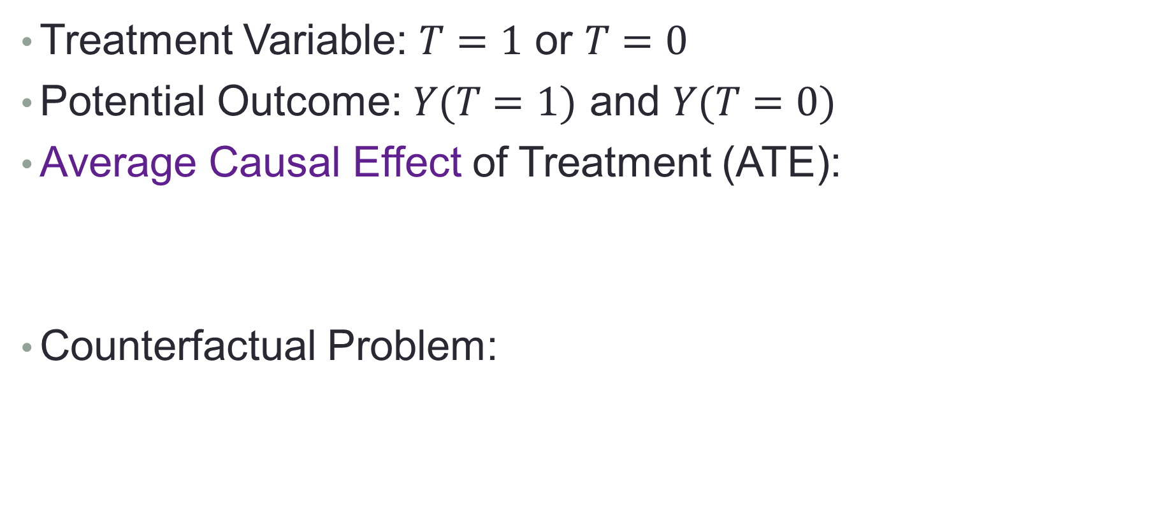
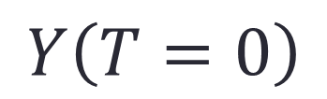
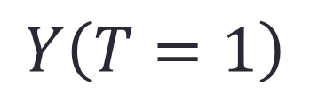
Causal Effect Estimation
Treatment Variable: $T=1$ or $T=0$
Potential Outcome: $Y(T=1)$ and $Y(T=0)$
Average Causal Effect of Treatment (ATE):
Counterfactual Problem:
$$ATE=E[Y\left(T=1\right)−Y\left(T=0\right)]$$
$$Y\left(T=1\right)$$
or
$$Y\left(T=0\right)$$

Slide 27
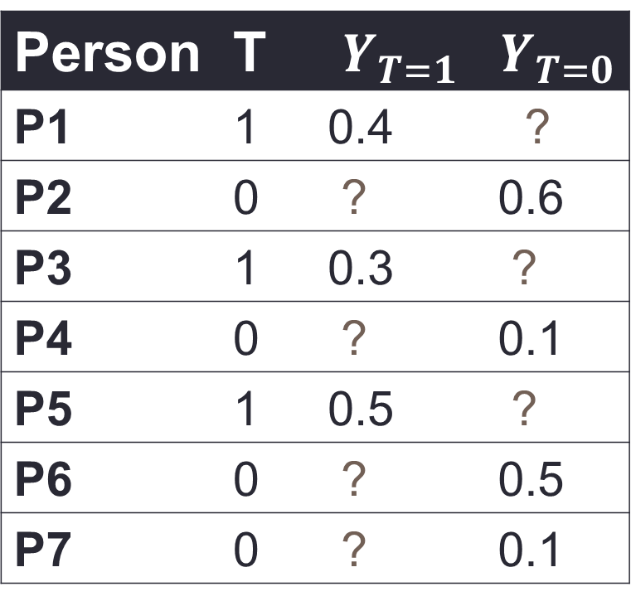
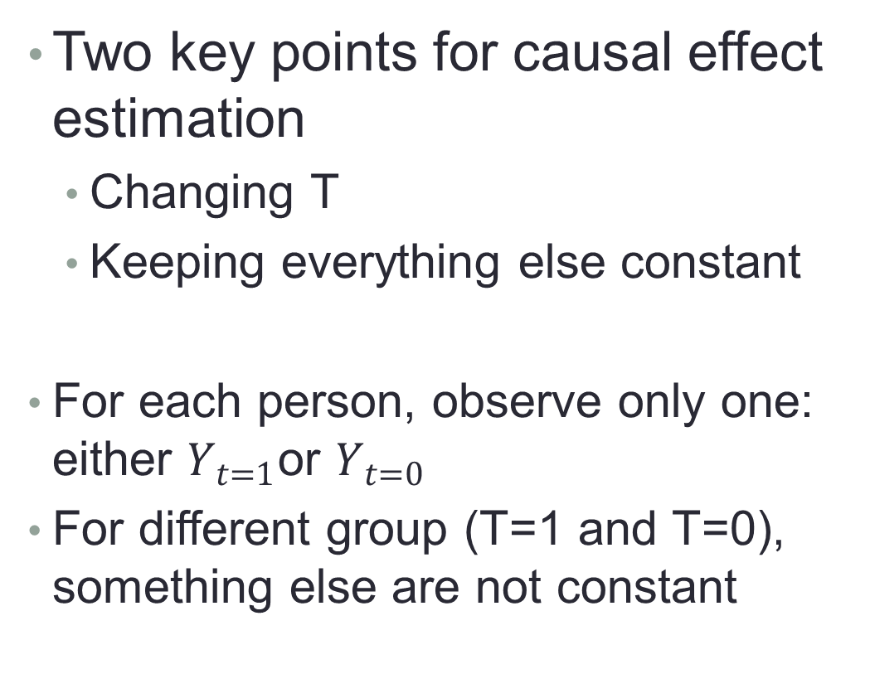
Counterfactual Problem
Two key points for causal effect estimation
Changing T
Keeping everything else constant
For each person, observe only one: either $Y_{t=1}$or $Y_{t=0}$
For different group (T=1 and T=0), something else are not constant
Person | T | $$Y_{T=1}$$ | $$Y_{T=0}$$
P1 | 1 | 0.4 | ?
P2 | 0 | ? | 0.6
P3 | 1 | 0.3 | ?
P4 | 0 | ? | 0.1
P5 | 1 | 0.5 | ?
P6 | 0 | ? | 0.5
P7 | 0 | ? | 0.1

Slide 28
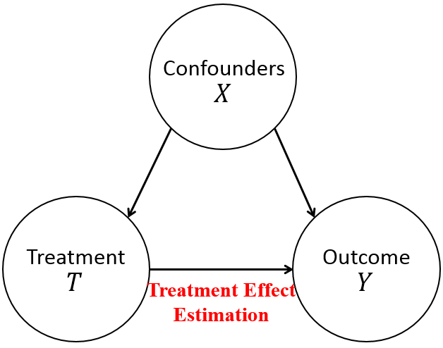
Potential Outcome Framework
Confounders X: everything else
Why keep everything else constant:
Confounders X influences both T and Y
Y’s change could be induced by change of T or since X changed both T and Y?
In different group, keep confounders the same!

Slide 29



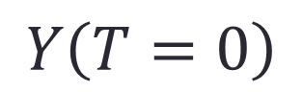
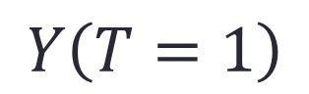
Ideal Solution: Counterfactual World
Reason about a world that does not exist
Everything is the same on real and counterfactual worlds, but the treatment
$$Y\left(T=1\right)$$
$$Y\left(T=0\right)$$

Slide 30





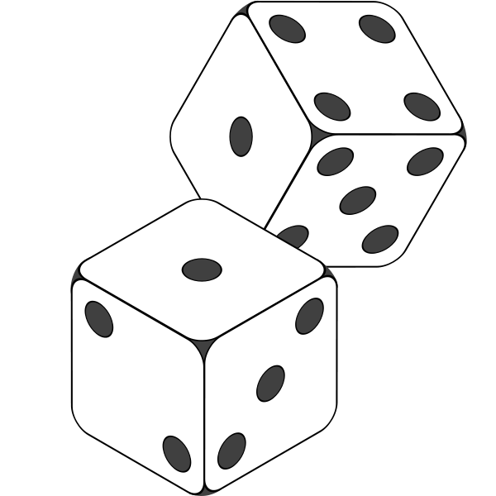



Randomized Experiments are the “Gold Standard”
Drawbacks of randomized experiments:
Cost
Unethical

Slide 31
Randomized Experiments are the “Gold Standard”
What can we do when an experiment is not possible?
Observational Studies!
Drawbacks of randomized experiments:
Cost
Unethical

Slide 32
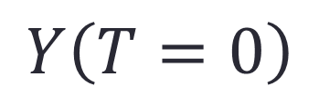
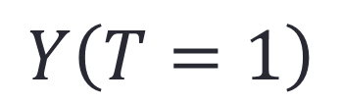
Recap: Causal Effect and Potential Outcome
Two key points for causal effect estimation
Changing T
Keeping everything else (X) constant
Counterfactual Problem
Ideal Solution: Counterfactual World
“Gold Standard”: Randomized Experiments
We will discuss other solutions in Section 2.
$$Y\left(T=1\right)$$
or
$$Y\left(T=0\right)$$

Slide 33
OUTLINE
PART I. Introduction to Causal Inference
PART II. Methods for Causal Inference
PART III. Causally Regularized Machine Learning
PART IV. Benchmark and Open Datasets
PART V. Conclusion and Discussion

Slide 34
Causal Inference with Observational Data
Average Treatment Effect (ATE) represents the mean (average) difference between the potential outcome of units under treated (T=1) and control (T=0) status.
Treated (T=1): taking a particular medication
Control (T=0): not taking any medications
ATE: the causal effect of the particular medication
$$ATE=E[Y\left(T=1\right)−Y\left(T=0\right)]$$
Notes:
As introduced before, under potential outcome framework, the average causal effect or average treatment effect can be defined as the mean difference between the potential outcome of units under treated and control status, where the Y(1) and Y(0) represent the potential outcome of units with treatment status as treated T=1 and control T=1, respectively.
For example, we want to estimate the causal effect of a particular medication, where treated status means taking that medication, control status means not taking any medications, then the ATE represents the causal effect of that medication.

Slide 35
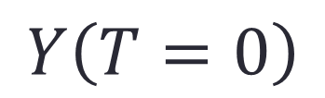
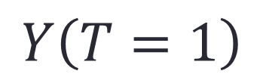
Causal Inference with Observational Data
Counterfactual Problem:
Can we estimate ATE by directly comparing the average outcome between treated and control groups?
Yes with randomized experiments (X are the same)
No with observational data (X might be different)
Two key points:
Changing T (T=1 and T=0)
Keeping everything else (Confounder X) constant
$$Y\left(T=1\right)$$
or
$$Y\left(T=0\right)$$
Notes:
From the definition of ATE, we know there is a counterfactual problem. That is, for each unit, we can only observe one of two potential outcomes, treated or control, not both.
So there is a question, under the counterfactual problem, ca we estimate …
It depends on your data. If your data are from randomized experiments, the answer is YES.
Do you still remember the two key points for estimating causal effect: one is changing T, this condition is satisfied since we have two different value of T; the other is keeping everything else constant, that is the confounder should be the same between group T=1 and Groups T=0, this condition can be guaranteed by randomized experiments. Hence, we can directly comparing .. If our data are from randomized experiments.
But we cannot if our data are observational data or historical data. In observational data, we also have units with different treatment T, but their treatment status might be affected by their other features, we say confounders X, leading to the different distribution on confounders.
For example, for a very expensive medication, taking or not majorly depends on the patients’ income, leading to the distribution of income variable become different between treated and control groups.
Hence, if we want to estimate the causal effect from observational data, we need to balance confounders’ distribution.

Slide 36
Causal Inference with Observational Data
Counterfactual Problem:
Can we estimate ATE by directly comparing the average outcome between treated and control groups?
Yes with randomized experiments (X are the same)
No with observational data (X might be different)
Two key points:
Changing T (T=1 and T=0)
Keeping everything else (Confounder X) constant
$$Y\left(T=1\right)$$
or
$$Y\left(T=0\right)$$
Balancing Confounders’ Distribution
Notes:
From the definition of ATE, we know there is a counterfactual problem. That is, for each unit, we can only observe one of two potential outcomes, treated or control, not both.
So there is a question, under the counterfactual problem, ca we estimate …
It depends on your data. If your data are from randomized experiments, the answer is YES.
Do you still remember the two key points for estimating causal effect: one is changing T, this condition is satisfied since we have two different value of T; the other is keeping everything else constant, that is the confounder should be the same between group T=1 and Groups T=0, this condition can be guaranteed by randomized experiments. Hence, we can directly comparing .. If our data are from randomized experiments.
But we cannot if our data are observational data or historical data. In observational data, we also have units with different treatment T, but their treatment status might be affected by their other features, we say confounders X, leading to the different distribution on confounders.
For example, for a very expensive medication, taking or not majorly depends on the patients’ income, leading to the distribution of income variable become different between treated and control groups.
Hence, if we want to estimate the causal effect from observational data, we need to balance confounders’ distribution.

Slide 37
Methods for Causal Inference
Matching
Propensity Score Based Methods
Propensity Score Matching
Inverse of Propensity Weighting (IPW)
Doubly Robust
Data-Driven Variable Decomposition (D²VD)
Directly Confounder Balancing
Entropy Balancing
Approximate Residual Balancing
Differentiated Confounder Balancing (DCB)
Notes:
To balance confounders’ distribution, there are three main kind of methods, including matching methods, propensity score based methods, and directly confounder balancing approaches.

Slide 38
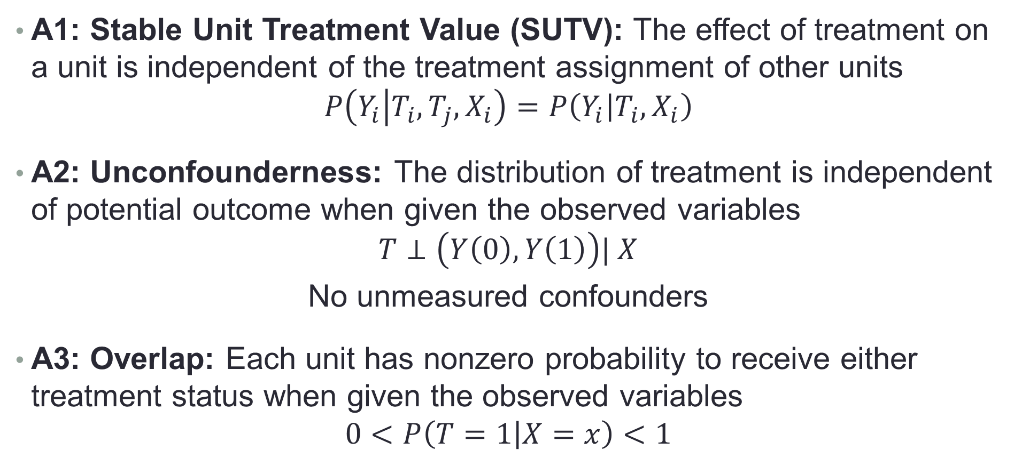
Assumptions of Causal Inference
A1: Stable Unit Treatment Value (SUTV): The effect of treatment on a unit is independent of the treatment assignment of other units
$$P\left(Y_{i} | T_{i},T_{j},X_{i}\right)=P\left(Y_{i} | T_{i},X_{i}\right)$$
A2: Unconfounderness: The distribution of treatment is independent of potential outcome when given the observed variables
$$T⊥\left(Y\left(0\right),Y\left(1\right)\right)| X$$
No unmeasured confounders
A3: Overlap: Each unit has nonzero probability to receive either treatment status when given the observed variables
$$0<P\left(T=1 | X=x\right)<1$$
Notes:
Before introducing the details of each method, we firstly introduce the assumptions for causal inference in observational studies.
The first assumption is … For example, the causal effect of a particular medication on me is independent with whether peng take a medication or not.
The second assumption is Unconfounderness, we also called as ignorability. That is … This assumption demonstrate that all confounders are observed, there are no unmeasured confounders.
The third assumption is overlap, that is …
With these three assumptions, we can precisely estimate causal effect from observational data if we can balance all confounders.

Slide 39
Methods for Causal Inference
Matching
Propensity Score Based Methods
Propensity Score Matching
Inverse of Propensity Weighting (IPW)
Doubly Robust
Data-Driven Variable Decomposition (D²VD)
Directly Confounder Balancing
Entropy Balancing
Approximate Residual Balancing
Differentiated Confounder Balancing
Notes:
Under above assumptions, we will first introduce the matching method for causal inference next.

Slide 40

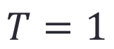
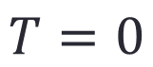
Matching
$$T=0$$
$$T=1$$
Notes:
In observational data, we have units from both treated and control, but their confounders’ distribution might be different, leading to we cannot estimate the causal effect by directly comparing their average outcome.

Slide 41
Matching
Notes:
To balance the confounders’ distribution between treated and control groups, matching method propose to match each unit i with unit j if they have similar features but different treatment status.
In the carton example, we use the shape and color to demonstrate the patients’ feature
Then, for each patient without taking medication, we find a patient that taking the medication but has similar feature to match.
Similarly, for each patient with taking the medication, we find a patient that not taking medication but has similar feature to match.
As for those patients that have no suitable patient to match, we just discard their data.

Slide 42
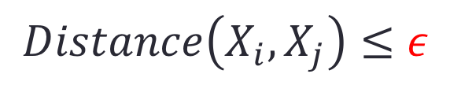
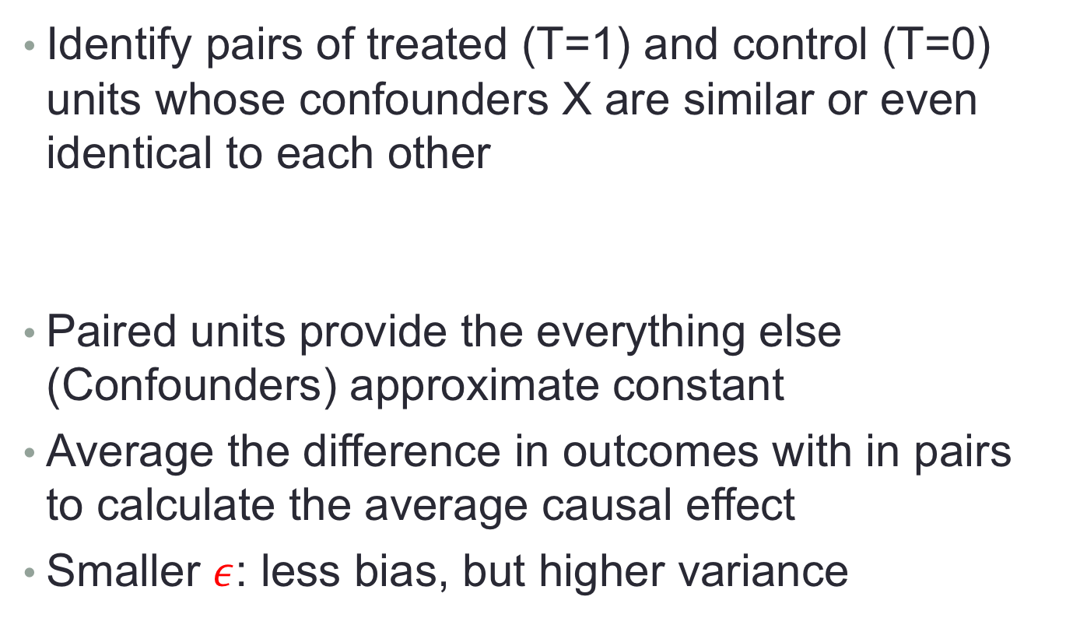


Matching
Identify pairs of treated (T=1) and control (T=0) units whose confounders X are similar or even identical to each other
Paired units provide the everything else (Confounders) approximate constant
Average the difference in outcomes with in pairs to calculate the average causal effect
Smaller $ε$: less bias, but higher variance
$$Distance\left(X_{i}, X_{j}\right)≤ε$$
$$i$$
$$j$$
Notes:
In above matching process, a distance measurement is needed to describe the similarity between units, if their distance is less than epsilon, then we think they are similar and can be matched, otherwise, not.
Then, we can identify …
A small threshold epsilon can provide that the everything else between treated and control groups are approximate constant. Hence, we can estimate the average causal effect by comparing their outcome in the paired dataset.
Need to note that
In the distance measurement, the threshold \epsilon will affect the bias and variance of estimated causal effect. Smaller \epsilon help to balance confounder better, reducing the bias of causal effect estimation, but will decrease the number of treated and control pairs, leading to high variance of causal effect estimation.
So we need to carefully set epsilon when using matching methods.

Slide 43
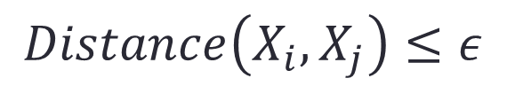
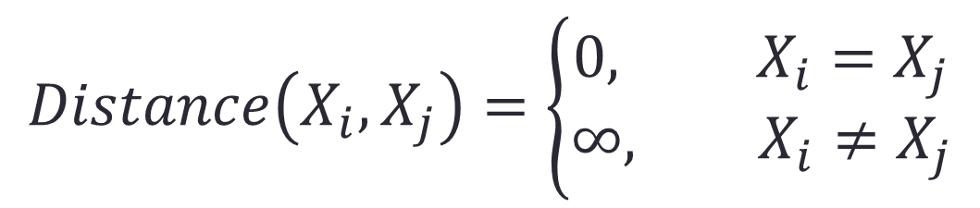
Matching
Exactly Matching:
Use this in low-dimensional settings
But in high-dimensional settings, there will be few exact matches
$$Distance\left(X_{i},X_{j}\right)=\left\{\begin{aligned}0, X_{i}=X_{j} \\ &∞, X_{i}≠X_{j}\end{aligned}\right.$$
$$i$$
$$j$$
$$Distance\left(X_{i}, X_{j}\right)≤ε$$
Notes:
If we set the distance measurement as follows. That is only two units with exactly the same features can be matched. This is exactly matching method.
Matching methods are easily implemented in real applications, but they are limited to low-dimensional settings. Since in high dimensional settings, we can hardly to find exact matches.

Slide 44
Methods for Causal Inference
Matching
Propensity Score Based Methods
Propensity Score Matching
Inverse of Propensity Weighting (IPW)
Doubly Robust
Data-Driven Variable Decomposition (D²VD)
Directly Confounder Balancing
Entropy Balancing
Approximate Residual Balancing
Differentiated Confounder Balancing
Notes:
To address the high dimensional challenges, we will introduce propensity score based methods, including …

Slide 45
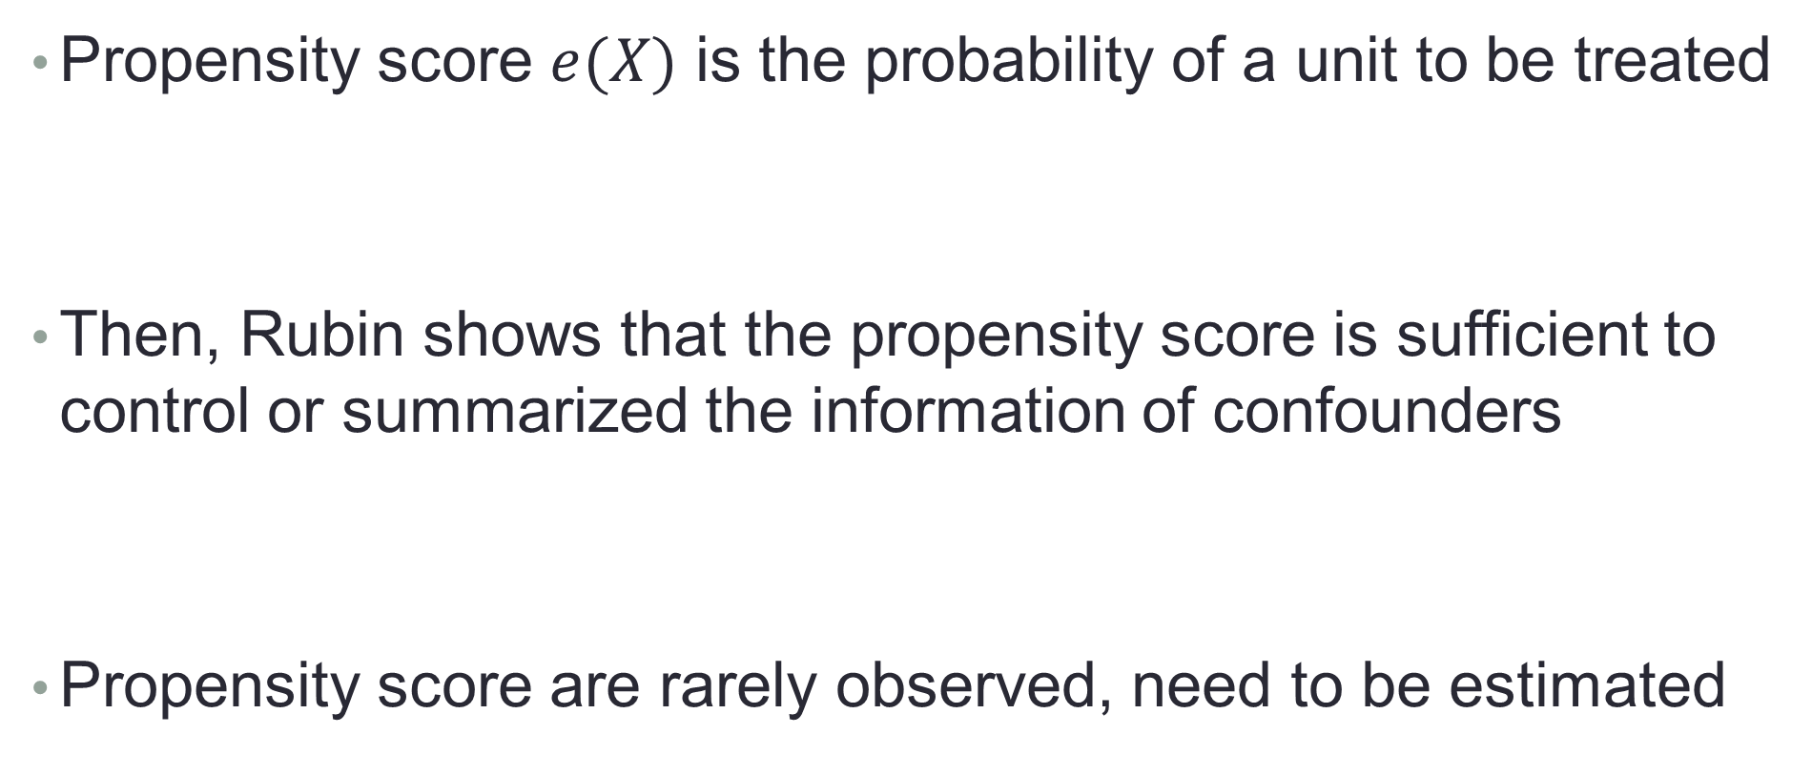
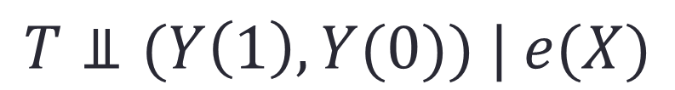
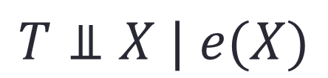
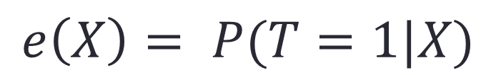
Propensity Score Based Methods
Propensity score $e(X)$ is the probability of a unit to be treated
Then, Rubin shows that the propensity score is sufficient to control or summarized the information of confounders
Propensity score are rarely observed, need to be estimated
$$e\left(X\right)= P(T=1|X)$$
$$T⫫X | e(X)$$
$$T⫫(Y\left(1\right),Y(0)) | e(X)$$
Notes:
First, the propensity score is defined as the propensity or probability of a unit to be treated. For example, the probability of taking the medication for a patient.
Then, Rubin … That is given propensity score, the treatment will become independently with confounder. With this result, one can easily prove that given the propensity score, the unconfounderness assumption is satisfied.
In real applications, however, we can hardly know the true propensity score, so need to estimate it.

Slide 46
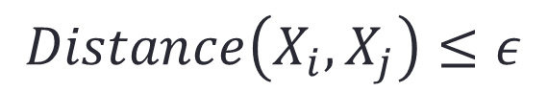
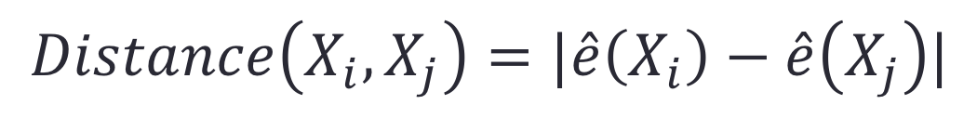
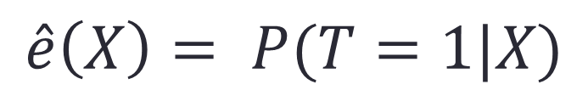
Propensity Score Matching
$$\hat{e}\left(X\right)= P(T=1|X)$$
Estimating propensity score:
Supervised learning: predicting a known label T based on observed covariates X.
Conventionally, use logistic regression
Matching pairs by distance between propensity score:
High dimensional challenge:
$$Distance\left(X_{i}, X_{j}\right)≤ε$$
$$Distance\left(X_{i}, X_{j}\right)=|\hat{e}\left(X_{i}\right)−\hat{e}\left(X_{j}\right)|$$
transferred from matching to PS estimation
Notes:
Estimating propensity score can be regarded as a supervised learning problem, you know, a classic binary classification problem, estimating the label of treatment T based on the observed variables X.
Logistical regression is the conventional method to estimate propensity score, other machine learning methods can also be applied to estimate propensity score.
Based on propensity score, we can define a distance measurement to match treated and control units pair. This is Propensity score matching method.
In previous matching method, the main challenge is from high dimensional variables when matching. In PSM, high dimensional challenge is transferred form matching step to propensity score estimation step. And propensity score estimation is a supervised learning methods, many regularizer can be applied to address the high dimensional problem, for example LASSO.

Slide 47
Methods for Causal Inference
Matching
Propensity Score Based Methods
Propensity Score Matching
Inverse of Propensity Weighting (IPW)
Doubly Robust
Data-Driven Variable Decomposition (D²VD)
Directly Confounder Balancing
Entropy Balancing
Approximate Residual Balancing
Differentiated Confounder Balancing

Slide 48
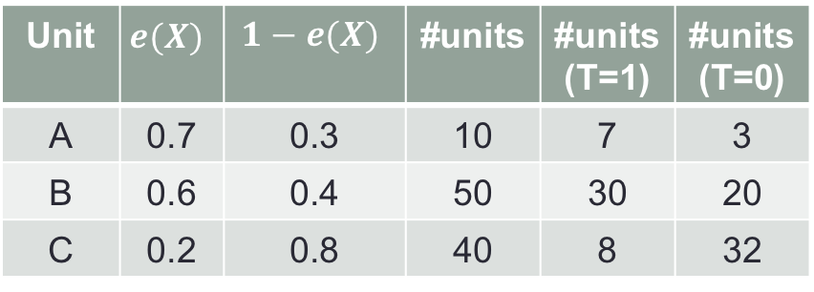
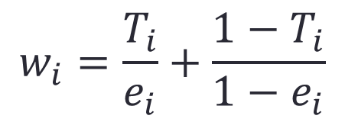
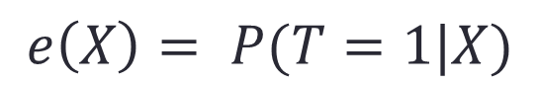
Inverse of Propensity Weighting (IPW)
Why weighting with inverse of propensity score is helpful?
Propensity score induces the distribution bias on confounders X
$$e\left(X\right)= P(T=1|X)$$
Unit | $$e(X)$$ | $$1−e(X)$$ | #units | #units(T=1) | #units(T=0)
A | 0.7 | 0.3 | 10 | 7 | 3
B | 0.6 | 0.4 | 50 | 30 | 20
C | 0.2 | 0.8 | 40 | 8 | 32
Unit | #units(T=1) | #units(T=0)
A
B
C
10
10
Confounders are the same!
50
50
40
40
Distribution Bias
$$w_{i}=\frac{T_{i}}{e_{i}}+\frac{1−T_{i}}{1−e_{i}}$$
Reweighting by inverse of propensity score:
Notes:
Next, we will introduce a widely used propensity score based method, the Inverse of Propensity Weighting method.
IPW was proposed to reweight samples by their inverse of propensity score for confounder balancing.
We will give a toy example to explain why weighting is helpful.
In our example, we have three kinds of units, U1, U2 and U3, and different units with different propensity score to be treated. For example, the Unit U1, its propensity score is 0.7, if we observed 10 units 1 in our data, there would be 7 treated U1 and 3 control U1 ideally. Similarity, for unit U2, there would be 30 treated and 20 control, and for U3, 8 treated and 32 control.
Finally, we will found that the distribution of confounders X will be different between the treated group and control groups, where we observed 7 U1, 30 U2, and 8 U3 in treated group, while we observed 3 U1, 20 U2 and 32 U3 in control group. And this distribution bias is induced by the propensity score.
If we know the exactly propensity score of each unit, we can reweight them by the inverse of propensity score, specifically, for a treated unit T=1, we reweight it by the inverse of propensity score, for a control unit, we reweight it by the inverse of 1 minus propensity score. For example, for the treated U1, we weight them by 1 over 0.7, we can obtain 10 treated U1, and for the control U1, we reweight them by 1 over 0.3, we also can get 10 control U1, similarity for U2 and U3. Finally, we would find that the number of each kind of Units are the same between treated and control groups after reweighting.
That is by sample reweighting with the inverse of propensity score, we can make the confounders between treated and control groups become the same.

Slide 49
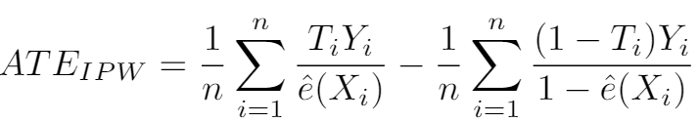
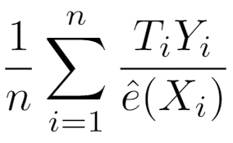

Inverse of Propensity Weighting (IPW)
$$w_{i}=\frac{T_{i}}{e_{i}}+\frac{1−T_{i}}{1−e_{i}}$$
Estimating ATE by IPW [1]:
Interpretation: IPW creates a pseudo-population where the confounders are the same between treated and control groups.
Why does this work? Consider
Notes:
Then, we can estimate the average treatment effect by inverse of propensity weighting as follows. After sample reweighting, the average treatment effect can be estimated by using the weighted mean value of outcome on treated groups to minus that one on control group, where the e hat represents the estimated propensity score, since we can hardly know the exactly propensity score in many real applications.
The interpretation of IPW estimation is that, the inverse of propensity weighting creates …
In previous toy example we demonstrate why inverse propensity score works, next we will prove that with theoretical analysis. Let’s firstly consider the treated component.
\begin{eqnarray}ATE = \frac{1}{n}\sum_{i=1}^{n}\frac{T_iY_i}{\hat{e}(X_i)} - \frac{1}{n}\sum_{i=1}^{n}\frac{(1-T_i)Y_i}{1-\hat{e}(X_i)}\end{eqnarray}

Slide 50







Inverse of Propensity Weighting (IPW)
If: , the true propensity score
Similarly:
$$Y=T∗Y_{1}+\left(1−T\right)∗Y_{0}$$
$$T⊥\left(Y_{1},Y_{0}\right) | X$$
$$e\left(X\right)=E(T|X)$$
$$ATE=E[Y\left(1\right)−Y\left(0\right)]$$
Notes:
By assuming that the estimated propensity score e hat is exactly the true propensity score, then we have following results:
First, from the equation of Y, we have that the expectation of TY over e(X) equals to the expectation of TY1 over e(X)
Then, with the unconfounderness assumption, that given X, T is independent with Y1 and Y0, we have that the expectation of T given Y1 and X equals to the expectation of T given X.
Finally, by the definition of propensity score e(X), we know the expectation of T given X is the propensity score.
Hence, we can prove that the expectation of TY over e(X) is exactly the expectation of potential outcome Y1.
Similarity, we can also prove that the expectation of (1-T)Y over (1-e(X)) equals to the expectation of potential outcome Y0.
Recall that the average treatment effect is defined as the expectation of difference between potential outcome Y1 and Y0, we know that
TY = T{T*Y_1+(1-T)*Y_0} = T^2 * Y_1 + T(1-T)Y_0 (T is binary)
Ignorability: (Y_1, Y_0) _||_ T | X
e(X) = E(T|X)
\begin{eqnarray} E\left\{\frac{T Y}{e({X})}\right\} &=& E\left\{\frac{T Y_{1}}{e({X})}\right\}=E\left[E\left\{\frac{T Y_{1}}{e({X})} | Y_{1}, {X}\right\}\right] \\&=&E\left\{\frac{Y_{1}}{e({X})} E(T | Y_{1}, {X})\right\}=E\left\{\frac{Y_{1}}{e({X})} E(T | {X})\right\} \\&=&E\left\{\frac{Y_{1}}{e({X})} e({X})\right\}=E\left(Y_{1}\right) \end{eqnarray}

Slide 51


Inverse of Propensity Weighting (IPW)
If: , the true propensity score, the IPW estimator is unbiased
Wildly used in many applications
But requires the propensity score model is correct
High variance when $e$ is close to 0 or 1
Notes:
If the estimated propensity score the exactly the true propensity score, then the IPW estimator is unbiased for treatment effect estimation.
The IPW estimator is widely used and achieved good performance in many real applications.
But is there any disadvantage or drawback for IPW estimator?
One is that IPW need the estimated propensity score is exactly the true propensity score, so it requires the propensity score model is correct.
Second is that when estimated propensity score is close to 0 and 1, the weight would be huge, leading to high variance of treatment effect estimation.

Slide 52
Methods for Causal Inference
Matching
Propensity Score Based Methods
Propensity Score Matching
Inverse of Propensity Weighting (IPW)
Doubly Robust
Data-Driven Variable Decomposition (D²VD)
Directly Confounder Balancing
Entropy Balancing
Approximate Residual Balancing
Differentiated Confounder Balancing

Slide 53


Doubly Robust
Recap:
Simple outcome regression:
Unbiased if the regression models are correct
IPW estimator:
Unbiased if the propensity score model is correct
Doubly Robust [2]: combine both approaches
$$ATE=E[Y\left(T=1\right)−Y\left(T=0\right)]$$
and
Notes:
Next, we will introduce another method based on propensity score, doubly robust method
From the definition of ATE, we know that one can estimate ATE if he knows the potential outcome Y1 and Y0 for each units.
But in observational data, we know only one potential outcome of each unit. A simple way to address this problem is to predict the unobserved potential outcome.
In simple outcome regression, we learn regression model for treated group and control group, respectively.
The simple outcome regression method is unbiased if the regression models are correct.
Recap that IPW method we introduced before also need the correct model specification to guarantee the unbiasedness.
Then, the doubly robust method was proposed by combining both outcome regression and IPW method in a fortuitous way.

Slide 54

Doubly Robust
Estimating ATE with Doubly Robust estimator:
Unbiased if either propensity score or regression model is correct
This property is referred to as double robustness
Notes:
By combining regression and IPW method, the doubly robust estimator can be represented as following, where e hat is estimated propensity score, and m1 m0 are outcome regression models.
Either propensity score model or outcome regression model is correct, the doubly robust estimator is unbiased to estimate average causal effect.
This property is referred to as double robustness.
\begin{eqnarray}ATE_{DR}&=& \frac{1}{n} \sum_{i=1}^{n}\left[\frac{T_{i} Y_{i}}{\hat{e}(X_i)}-\frac{\left\{T_{i}-\hat{e}(X_i)\right\}}{\hat{e}(X_i)} \hat{m}_1(X_i)\right] \\ &\_& - \frac{1}{n} \sum_{i=1}^{n}\left[\frac{\left(1-T_{i}\right) Y_{i}}{1-\hat{e}(X_i)}+\frac{\left\{T_{i}-\hat{e}(X_i)\right\}}{1-\hat{e}(X_i)} \hat{m}_{0}(X_i)\right] \end{eqnarray}

Slide 55

Doubly Robust
Theoretical Proof:
Notes:
Here, we give the proof of unbiasedness of doubly robust method. We firstly proved the treated part equals to the expectation of Y1, since the term in the red rectangle would equal 0 if either e hat equals to true propensity score, or the m1 equals to Y1.
Similarity, we can prove the control part in doubly robust estimator equals the expectation of Y0.

Slide 56
Doubly Robust
Estimating ATE with Doubly Robust estimator:
Unbiased if propensity score or regression model is correct
This property is referred to as double robustness
But may be very biased if both models are incorrect
Notes:
But if both models are incorrect, doubly robust method would be very biased.
\begin{eqnarray}ATE_{DR}&=& \frac{1}{n} \sum_{i=1}^{n}\left[\frac{T_{i} Y_{i}}{\hat{e}(X_i)}-\frac{\left\{T_{i}-\hat{e}(X_i)\right\}}{\hat{e}(X_i)} \hat{m}_1(X_i)\right] \\ &\_& - \frac{1}{n} \sum_{i=1}^{n}\left[\frac{\left(1-T_{i}\right) Y_{i}}{1-\hat{e}(X_i)}+\frac{\left\{T_{i}-\hat{e}(X_i)\right\}}{1-\hat{e}(X_i)} \hat{m}_{0}(X_i)\right] \end{eqnarray}

Slide 57

Propensity Score based Methods
Recap:
Propensity Score Matching
Inverse of Propensity Weighting
Doubly Robust
Need to estimate propensity score
Treat all observed variables as confounders
In Big Data Era, High dimensional data
But, not all variables are confounders
Notes:
We have introduced three kinds of propensity score based methods, including …
In PSM, we match treated and control pairs by their propensity score. In IPW, we reweight samples by their inverse of propensity score. Doubly robust method combined both IPW estimator and outcome regression method.
All of these propensity score based method need to estimate propensity score, and their performance depends on the accuracy of estimated propensity score.
However, all of these methods treat all observed variables as confounder when estimating propensity score.
In practical, especially in big data era, we always observed hundred and thousand variables, but not all of those variables are confounders, only that related to treatment variables and outcome variable are confounders, and some non-confounders are helpful on treatment effect estimation.
Hence, to precisely estimate the average causal effect in high dimensional setting, we need to separate the confounders.
But the question is how to automatically separate the confounders from all observed variables.

Slide 58
Propensity Score based Methods
Recap:
Propensity Score Matching
Inverse of Propensity Weighting
Doubly Robust
Need to estimate propensity score
Treat all observed variables as confounders
In Big Data Era, High dimensional data
But, not all variables are confounders
How to automatically separate the confounders?
Notes:
We have introduced three kinds of propensity score based methods, including …
In PSM, we match treated and control pairs by their propensity score. In IPW, we reweight samples by their inverse of propensity score. Doubly robust method combined both IPW estimator and outcome regression method.
All of these propensity score based method need to estimate propensity score, and their performance depends on the accuracy of estimated propensity score.
However, all of these methods treat all observed variables as confounder when estimating propensity score.
In practical, especially in big data era, we always observed hundred and thousand variables, but not all of those variables are confounders, only that related to treatment variables and outcome variable are confounders, and some non-confounders are helpful on treatment effect estimation.
Hence, to precisely estimate the average causal effect in high dimensional setting, we need to separate the confounders.
But the question is how to automatically separate the confounders from all observed variables.

Slide 59
Methods for Causal Inference
Matching
Propensity Score Based Methods
Propensity Score Matching
Inverse of Propensity Weighting (IPW)
Doubly Robust
Data-Driven Variable Decomposition (D²VD)
Directly Confounder Balancing
Entropy Balancing
Approximate Residual Balancing
Differentiated Confounder Balancing (DCB)

Slide 60



Inverse of Propensity Weighting (IPW)
Treat all observed variables U as confounders X
Propensity Score Estimation:
Adjusted Outcome:
IPW ATE Estimator:
Notes:
In traditional IPW estimator, the all observed variables are regarded as confounder X, and estimate the propensity score with U. With the estimated propensity score, IPW estimate reweights sample and their outcome by the inverse of propensity score, and finally estimate the average causal effect by the expectation of the adjusted outcome.

Slide 61



Data-Driven Variable Decomposition (D²VD)
Separateness Assumption:
All observed variables U can be decomposed into three sets: Confounders X, Adjustment Variables Z, and Irrelevant variables I (Omitted).
Propensity Score Estimation:
Adjusted Outcome:
Our D²VD ATE Estimator:
Notes:
Comparing with previous causal framework, we propose a new causal framework.
In our causal framework, we assume all the observed variables U can be decomposed into three sets:
(1) Confounders X, which are associated with the treatment T and may be causally related to the outcome Y.
(2) Adjustment Variables Z, which are causally related to outcome Y , but independent with treatment T.
and (3) Irrelevant variables I, which are independent with both treatment and outcome and omitted in our causal framework.
With the separated confounder X, we can precisely estimate the propensity score, and with the separated adjustment variables Z, we can regressing Y on them to remove the variance of Y.
Finally, based on our adjusted outcome, we can estimate the average treatment effect by the expectation of adjusted outcome.

Slide 62




Data-Driven Variable Decomposition (D²VD)
Confounders Separation & ATE Estimation.
With our D²VD estimator:
By minimizing following objective function:
We can estimate the ATE as:
Notes:
Based on our causal framework, we proposed an data driven variables decomposition algorithm to jointly optimize confounders separation and ATE estimation.
skip
With our adjusted estimator, we can estimate the ATE by the expectation of adjusted outcome Y plus.
If we assume the treatment effect is heterogeneous and represented by function h(U), we can obtain the estimated ATE by regression out adjusted outcome Y plus against the variables U and minimizing following objective function.
Then, we can estimate the ATE by the expectation of function h(U).

Slide 63






Data-Driven Variable Decomposition (D²VD)
Where
Replace X, Z with U
Where
Adjustment variables:
Confounders:
Treatment Effect:
$$α, β, γ$$
Notes:
Here is the details of our algorithm, where we adopt logistic regression to evaluate the propensity score with coefficient vector \beta, and adopt a linear regression to adjust outcome with coefficient vector \alpha.
Then, we employ an orthogonal regularizer on \alpha and \beta for ensuring the separation of confounders and adjustment variables.
Finally, with the optimized parameters, we can separate the adjustment variables by parameter \alpha, separate the confounders by parameter \beta, and estimate the ATE by parameter \gamma.

Slide 64


Data-Driven Variable Decomposition (D²VD)
Bias Analysis:
Our D²VD algorithm is unbiased to estimate causal effect
Variance Analysis:
The asymptotic variance of Our D²VD algorithm is smaller
Notes:
Theoretically, we did both bias and variance analysis for our DVD estimator, we proved that …

Slide 65
Data-Driven Variable Decomposition (D²VD)
OUR: Data-Driven Variable Decomposition (D²VD)
Baselines
Directly Estimator (dir): ignores confounding bias
IPW Estimator (IPW): treats all variables as confounders
Doubly Robust Estimator (DR): IPW+regression
Non-Separation Estimator (D²VD-): no variables separation
Notes:
In our experiments, we compared our algorithm with following baselines, including …, where Non-separation estimator is a weak version of our algorithm, which has no variables separation.

Slide 66


Data-Driven Variable Decomposition (D²VD)
Dataset generation:
Sample size m={1000,5000}
Dimension of observed variables n={50,100,200}
Observed variables:
Treatment: logistic and misspecified
Outcome:
Notes:
First, we show the experiments on synthetic data.
We generate the observed variables U with independent Gaussian distribution.
To test the robustness of our estimator, we generate the binary treatment variable T from a logistic function and misspecified function.
The outcome Y is generated with linear regression on treatment T, confounders X and adjustment variables Z.
In the synthetic data, we know the true treatment effect is 1.

Slide 67
Data-Driven Variable Decomposition (D²VD)
Dataset generation:
Sample size m={1000,5000}
Dimension of observed variables n={50,100,200}
Observed variables:
Treatment: logistic and misspecified
Outcome:
The true treatment effect in synthetic data is 1.
Notes:
First, we show the experiments on synthetic data.
We generate the observed variables U with independent Gaussian distribution.
To test the robustness of our estimator, we generate the binary treatment variable T from a logistic function and misspecified function.
The outcome Y is generated with linear regression on treatment T, confounders X and adjustment variables Z.
In the synthetic data, we know the true treatment effect is 1.

Slide 68


Data-Driven Variable Decomposition (D²VD)
Experimental Results on Synthetic Data:
Notes:
Here, we show the results of ATE estimation on synthetic dataset. The bias refers to the absolute error between the true and estimated ATE. The smaller bias, SD, MAE and RMSE, the better. From the results, we have following observations.
1, The direct estimator is failed under different setting because it did not consider the confounding bias.
2, The IPW and DR estimators is good when treatment T from logistic function, but poor when treatment from a misspecied function.
3, The DVD(-) estimator, which has no variables separation, get similar results with DR estimator.
4, With considering the variables decomposition, our DVD algorithm can improve accuracy and reduce variance for ATE estimation.

Slide 69
Data-Driven Variable Decomposition (D²VD)
The direct estimator is failed under all settings.
IPW and DR estimators are good when T=T_{logit}, but poor when T=T_{missp}.
D²VD(-) has no variables separation, get similar results with DR estimator.
D²VD can improve accuracy and reduce variance for ATE estimation.
Experimental Results on Synthetic Data:
Notes:
Here, we show the results of ATE estimation on synthetic dataset. The bias refers to the absolute error between the true and estimated ATE. The smaller bias, SD, MAE and RMSE, the better. From the results, we have following observations.
1, The direct estimator is failed under different setting because it did not consider the confounding bias.
2, The IPW and DR estimators is good when treatment T from logistic function, but poor when treatment from a misspecied function.
3, The DVD(-) estimator, which has no variables separation, get similar results with DR estimator.
4, With considering the variables decomposition, our DVD algorithm can improve accuracy and reduce variance for ATE estimation.

Slide 70

Data-Driven Variable Decomposition (D²VD)
Experimental Results on Synthetic Data:
TPR: true positive rate
TNR: true negative rate
Our D²VD algorithm can precisely separate the confounders and adjustment variables.
Notes:
Here, we show the results of variables decomposition on synthetic data, where the TPR means true positive rate and TNR means true negative rate. The closer to 1 of TPR and TNR, the better.
The results demonstrate that our D²VD algorithm can precisely separate the confounders and adjustment variables.

Slide 71

Experiments on Real World Data
Dataset Description:
Online advertising campaign (LONGCHAMP)
Users Feedback: 14,891 LIKE; 93,108 DISLIKE
56 Features for each user
Age, gender, #friends, device, user setting on WeChat
Experimental Setting:
Outcome Y: users feedback
Treatment T: one feature
Observed Variables U: other features
2015
Y = 1, if LIKE
Y = 0, if DISLIKE
Notes:
We also apply our algorithm on real online advertising dataset. The data is about LONGCHAMP handbags campaign, collected from Tencent WeChat App. This campaign contains over 100,000 users feedback with LIKE and DISLIKE. And for each user, we have 56 features. In our experiments, we set the feedback of users about the ad as outcome, alternative set one user feature as treatment T and set other features as observed variables U. So, we can evaluate the causal effect of each user feature.

Slide 72

Experiments Results
ATE Estimation.
1. Our D²VD estimator evaluate the ATE more accuracy.
2. Our D²VD estimator can reduce the variance of estimated ATE.
3. Younger Ladies are with higher probability to like the LONGCHAMP ads.
Notes:
Here, we show the results of ATE estimation. From the results, we have following observations.
1. Our D²VD estimator evaluate the ATE more accuracy.
2. Our D²VD estimator can reduce the variance of estimated ATE.
3. The ATE of age bigger than 33 and male gender are negative, which indicate that the younger ladies are with higher probability to like the LONGCHAMP ads.

Slide 73

Experiments Results
Variables Decomposition.
1. The confounders are many other ways for adding friends on WeChat.
2. The adjustment variables have significant effect on outcome.
3. Our D²VD algorithm can precisely separate the confounders and adjustment variables.
Notes:
Here we show the variables decomposition results when we set feature “Add friend by Shake” as treatment. In the results, the separated confounders are many other ways for adding friends on WeChat, and the separated adjustment variables have significant effect on outcome. The results demonstrate that our DVD algorithm can precisely separate the confounders and adjustment variables.

Slide 74

Summary: Propensity Score based Methods
$$e\left(X\right)= P(T=1|X)$$
Propensity Score Matching (PSM):
Units matching by their propensity score
Inverse of Propensity Weighting (IPW):
Units reweighted by inverse of propensity score
Doubly Robust (DR):
Combing IPW and regression
Data-Driven Variable Decomposition (D²VD):
Automatically separate the confounders and adjustment variables
Confounder: estimate propensity score for IPW
Adjustment variables: regression on outcome for reducing variance
Improving accuracy and reducing variance on treatment effect estimation
But, these methods need propensity score model is correct
Treat all observed variables as confounder, ignoring non-confounders
Notes:
Here, we give a summary on propensity score based methods for treatment effect estimation.
The propensity score is defined as the probability of getting treated for each unit.
Based on propensity score, propensity score matching method match units that are with similar propensity score but different treatment status to guarantee the confounders’ distribution are similar between the treated and control group.
In IPW method, the confounders can be balanced by sample reweighting with their inverse of propensity score.
DR combined IPW and regression model, achieved double robustness.
Traditional propensity score based methods treated all observed variables as confounder when estimating propensity score, leading to bad performance in high dimensional setting.
In practical, not all observed variables are confounders. Hence, the data-driven variable decomposition algorithm proposed to automatically separate the confounders and adjustment variables, where the confounder … and the adjustment variables can be used to regress on outcome for reduce variance.
Overall, propensity score based method need to estimate the propensity score, hence requiring the assumed propensity score model is correct.

Slide 75
Methods for Causal Inference
Matching
Propensity Score Based Methods
Propensity Score Matching
Inverse of Propensity Weighting (IPW)
Doubly Robust
Data-Driven Variable Decomposition (D²VD)
Directly Confounder Balancing
Entropy Balancing
Approximate Residual Balancing
Differentiated Confounder Balancing (DCB)
Notes:
To avoid model misspecification on propensity score model, some researchers proposed directly confounder balancing methods for treatment effect estimation, bypassing propensity score estimation.

Slide 76
Causal Inference with Observational Data
Average Treatment Effect (ATE):
Average Treatment effect on the Treated (ATT):
Two key points:
Changing T (T=1 and T=0)
Keeping everything else (Confounder X) constant
$$ATE=E[Y\left(T=1\right)−Y\left(T=0\right)]$$
$$ATT=E[Y\left(1\right)|T=1]−E[Y\left(0\right)|T=1]$$
Notes:
Based on the definition of ATE, we give the definition of ATT, the average treatment effect on the treated.
Recall that the two key points for estimating causal effect are …
In our observational data, we observed treated units and control units, but the confounder X between treated and control group might be different. Hence, to precisely estimate ATT and ATE, we need to balance confounders between treated and control units.

Slide 77
Causal Inference with Observational Data
Average Treatment Effect (ATE):
Average Treatment effect on the Treated (ATT):
Two key points:
Changing T (T=1 and T=0)
Keeping everything else (Confounder X) constant
$$ATE=E[Y\left(T=1\right)−Y\left(T=0\right)]$$
$$ATT=E[Y\left(1\right)|T=1]−E[Y\left(0\right)|T=1]$$
Balancing Confounders’ Distribution
Notes:
Based on the definition of ATE, we give the definition of ATT, the average treatment effect on the treated.
Recall that the two key points for estimating causal effect are …
In our observational data, we observed treated units and control units, but the confounder X between treated and control group might be different. Hence, to precisely estimate ATT and ATE, we need to balance confounders between treated and control units.

Slide 78

Directly Confounder Balancing
Recap: Propensity score based methods
Sample reweighting for confounder balancing
But, need propensity score model is correct
Weights would be very large if propensity score is close to 0 or 1
Can we directly learn sample weight that can balance confounders’ distribution between treated and control?
$$w_{i}=\frac{T_{i}}{e_{i}}+\frac{1−T_{i}}{1−e_{i}}$$
Yes!
Notes:
As we introduced before, propensity score can be implied for confounder balancing by sample reweighting.
But those methods need propensity score model is correct, and the inverse of propensity weight would be very large if the estimated propensity score is close to 0 or 1, leading to high variance of estimated causal effect.
So, some researchers thought that why we need propensity score, can we just bypass propensity score estimation, and directly learn a sample weight that can …
The answer is YES.

Slide 79

Directly Confounder Balancing
Motivation: The collection of all the moments of variables uniquely determine their distributions.
Methods: Learning sample weights by directly balancing confounders’ moments as follows
The first moments of X on the Treated Group
The first moments of X on the Control Group
With moments, the sample weights can be learned without any model specification.
Notes:
The motivation of directly confounder balancing is that …
Hence, in order to balancing confounders’ distribution, some methods were proposed to learn sample weight by directly balancing confounders’ moments as follows, where X_T bar means the first moments of confounder X on the treated group, and X_c transpose W refers to the first moment of X on the control group with sample weight W.
By minimizing the difference of moments between treated and control groups, we can learn a sample weight that achieves the confounder balancing.
With the learned sample weights W, one can estimate the ATT by comparing weighted outcome between treated and control groups.

Slide 80

Directly Confounder Balancing
Motivation: The collection of all the moments of variables uniquely determine their distributions.
Methods: Learning sample weights by directly balancing confounders’ moments as follows
Estimating ATT by:
The first moments of X on the Treated Group
The first moments of X on the Control Group
Notes:
The motivation of directly confounder balancing is that …
Hence, in order to balancing confounders’ distribution, some methods were proposed to learn sample weight by directly balancing confounders’ moments as follows, where X_T bar means the first moments of confounder X on the treated group, and X_c transpose W refers to the first moment of X on the control group with sample weight W.
By minimizing the difference of moments between treated and control groups, we can learn a sample weight that achieves the confounder balancing.
With the learned sample weights W, one can estimate the ATT by comparing weighted outcome between treated and control groups.

Slide 81

Entropy Balancing
Maximum the entropy of sample weights W
Directly confounder balancing by sample weights W
But, treat all variables as confounders and balance them equally
Notes:
Here, we show the objective function of Entropy Balancing method, where they balance confounders based on their first moment by learning sample weights W, they also maximize the entropy of sample weights.
But, from their confounder balancing term, we know that they treat all observed variables as confounders and balance them equally.

Slide 82




Approximate Residual Balancing
1. compute approximate balancing weights W as
2. Fit $β_{c}$ in the linear model using a lasso or elastic net,
3. Estimate the ATT as
Double Robustness: Exact confounder balancing or regression is correct.
But, treats all variables as confounders and balance them equally
Notes:
As for approximate residual balancing method, there are three main steps. In the first step, they also directly balance confounders based on the first moment by learning sample weights W, and minimize the variance of sample weights W with a L2 norm.
In the second step, they apply a regression model to learn the potential outcome Y0, and utilize the LASSO or elastic net regularizer to address the high dimensional challenge.
Finally, based on the sample weights learned in step 1 and regression model in step 2, they estimate the ATT with residual of outcome.
Theoretically, we can prove that the approximate residual balancing method is double robustness if the sample weight W can exactly balance confounders or the regression model is correct.
But approximate residual balancing method also treats all variables as confounders and balance them equally.
$$
\widehat{ATT} = \sum_{i:T_i=1}\frac{1}{n_t}Y(1) - \sum_{j:T_j = 0}W_jY(0)
$$
\begin{equation}
\nonumber W=\operatorname{argmin}_{W}\left\{(1-\zeta)\|W\|_{2}^{2}+\zeta\left\|\overline{X}_{\mathrm{t}}-\mathbf{X}_{\mathrm{c}}^{\top} W\right\|_{\infty}^{2} \text { s.t. } \sum_{\left\{i : T_{i}=0\right\}} W_{i}=1 \text{ and } W_{i} \geq 0\right\}
\end{equation}
\begin{equation}
\nonumber \hat{\beta}_{\mathrm{c}}=\operatorname{argmin}_{\beta}\left\{\sum_{\left\{i : W_{i}=0\right\}}\left(Y_{i}^{\mathrm{obs}}-X_{i} \cdot \beta\right)^{2}+\lambda\left((1-\alpha)\|\beta\|_{2}^{2}+\alpha\|\beta\|_{1}\right)\right\}
\end{equation}
\begin{equation}
\nonumber \widehat{ATT}=\overline{Y}_{t}-\left(\overline{X}_{t} \cdot \hat{\beta}_{c}+\sum_{\left\{i : T_{i}=0\right\}} W_{i}\left(Y_{i}^{\mathrm{obs}}-X_{i} \cdot \hat{\beta}_{\mathrm{c}}\right)\right)
\end{equation}

Slide 83
Directly Confounder Balancing
Recap:
Entropy Balancing, Approximate Residual Balancing etc.
Moments uniquely determine variables’ distribution
Learning sample weights by balancing confounders’ moments
But, treat all variables as confounders, and balance them equally
Different confounders make different confounding bias
The first moments of X on the Treated Group
The first moments of X on the Control Group
Notes:
We have introduced two main methods for directly confounder balancing, including entropy balancing and approximate residual balancing. Their motivation is that moments uniquely determine the variables’ distribution, hence the confounder can be balanced by learning sample weight to minimize the distance of moments between treated and control groups.
But these method treat all variables as confounders and balance them equally. While, in real application, not all observed variables are confounders and different confounder make different confounding bias.
How to differentiated confounders and their bias is still a problem.

Slide 84
Directly Confounder Balancing
Recap:
Entropy Balancing, Approximate Residual Balancing etc.
Moments uniquely determine variables’ distribution
Learning sample weights by balancing confounders’ moments
But, treat all variables as confounders, and balance them equally
Different confounders make different confounding bias
How to differentiated confounders and their bias?
The first moments of X on the Treated Group
The first moments of X on the Control Group
Notes:
We have introduced two main methods for directly confounder balancing, including entropy balancing and approximate residual balancing. Their motivation is that moments uniquely determine the variables’ distribution, hence the confounder can be balanced by learning sample weight to minimize the distance of moments between treated and control groups.
But these method treat all variables as confounders and balance them equally. While, in real application, not all observed variables are confounders and different confounder make different confounding bias.
How to differentiated confounders and their bias is still a problem.

Slide 85
Methods for Causal Inference
Matching
Propensity Score Based Methods
Propensity Score Matching
Inverse of Propensity Weighting (IPW)
Doubly Robust
Data-Driven Variable Decomposition (D²VD)
Directly Confounder Balancing
Entropy Balancing
Approximate Residual Balancing
Differentiated Confounder Balancing (DCB)
Notes:
To address this problem, we propose a differentiated confounder balancing algorithm

Slide 86


Differentiated Confounder Balancing
Ideas: simultaneously learn confounder weights $β$ and sample weighs $W$.
Confounder weights determine which variable is confounder and its contribution on confounding bias.
Sample weights are designed for confounder balancing.
How to learn the these weights?
Notes:
In out differentiated confounder balancing algorithm we propose to simultaneously learn confounder weights beta and sample weights W, where the confounder weight determine which variable is confounder and its contribution on confounding bias, the sample weights W are designed for confounder balancing.
But how to learn these weights?

Slide 87






Confounder Weights Learning
General relationship among$X$, $T$, and $Y$:
Confounder weights
Confounding bias
If $α_{k}=0$, then $M_{k}$ is not confounder, no need to balance.
Different confounders have different confounding weights.
Notes:
First, confounder weights learning. In the causal framework, the general relationship among X, T, and Y can be represented as following, where we can obtain the real treatment effect ATT. With general function f(X), we find that there is a bias term between the real and estimated ATT on theory.
And the bias term can be decomposed as confounding bias of each augmented variable M_k, and a corresponding confounder weights alpha_k. From the deviation, we know that…
We also find that the confounder weights alpha_k is exactly the coefficient of M_k in function f(X).

Slide 88

Confounder Weights Learning
Propositions:
In observational studies, not all observed variables are confounders, and different confounders make unequal confounding bias on ATT with their own weights.
The confounder weights can be learned by regressing potential outcome $Y\left(0\right)$ on augmented variables $M$.
Notes:
Therefore, we give following propositions for confounder weights learning that …

Slide 89


Sample Weights Learning
Any variable’s distribution can be uniquely determined by the collection of all its moments.
Learning the sample weights $W$ by directly confounder balancing with confounders’ moments.
Confounders’ moments on the Treated Group
Confounders’ moments on the Control Group
With moments, the sample weights can be learned without any model specification.
Notes:
Second, sample weights learning. From Wikipedia, we know …
Inspired by this, we propose to learn the sample weights W by directly confounder balancing with confounders’ moments as following, where the M_t means the …, and M_c times W means the …
Therefore, with the help of moments, the sample weights can be learned by directly confounder balancing without any model specification.

Slide 90

Differentiated Confounder Balancing
Objective Function
The ENT[3] and ARB[4] algorithms are special case of our DCB algorithm by setting the confounder weights as unit vector.
Our DCB algorithm is more generalize for treatment effect estimation.
Notes:
Here is the final objective function of our differentiated confounder balancing algorithm, where the red part is for sample weights learning by directly confounder balancing, and the green part is for confounder weights learning by regressing outcome Y on augmented variables M.
Actually, …
Therefore,

Slide 91





Differentiated Confounder Balancing
Algorithm
Training Complexity: $O\left(np\right)$
$n$: sample size, $p$: dimensions of variables
In each iteration, we first update $β$ by fixing $W$, and then update $W$ by fixing $β$
Notes:
Here is the details of our DCB algorithm. The time complexity of our algorithm i is O(np), where n is the sample size and p is the dimensions of variables.

Slide 92
Experiments
Experimental Tasks:
Robustness Test (high-dimensional and noisy)
Accuracy Test (real world dataset)
Predictive Power Test (real ad application)
Notes:
In experiments, we check the performance of our DCB algorithm from three aspects. Firstly, robustness test under high dimensional and noisy data scenarios. Secondly, accuracy test on real world data for treatment effect estimation. Thirdly, predictive power test on a real online advertising application.

Slide 93

Experiments
Baselines:
Directly Estimator: comparing average outcome between treated and control units.
IPW Estimator [1]: reweighting via inverse of propensity score
Doubly Robust Estimator [2]: IPW + regression method
Entropy Balancing Estimator [3]: directly confounder balancing with entropy loss
Approximate Residual Balancing [4]: confounder balancing + regression
Evaluation Metric:
Notes:
We compared our algorithm with following methods.
The evaluation metric contains Bias, SD, MAE and RMSE.

Slide 94





Experiments - Robustness Test
Dataset
Sample size: $n=\{2000, 5000\}$
Variables’ dimensions: $p=\{50,100\}$
Observed Variables:
Treatment: from logistic function $T_{logit}$ and misspecified function $T_{missp}$
Confounding rate $r_{c}$: the ratio of confounders to all observed variables.
Confounding strength $s_{c}$: the bias strength of confounders
Outcome: from linear function $Y_{linear}$ and nonlinear function$Y_{nonlin}$
Notes:
Firstly, to test the robustness of our algorithm, we conducted extensive experiments on synthetic data, where we generate high dimensional and noisy data under different features dependence settings, including logistic and misspecified function on treatment T, linear and nonlinear function on outcome Y.

Slide 95

Experiments - Robustness Test
More results see our paper!
Directly estimator fails in all settings, since it ignores confounding bias.
IPW and DR estimators make huge error when facing high dimensional variables or the model specifications are incorrect.
ENT and ARB estimators have poor performance since they balance all variables equally.
Notes:
Here, we report a small part of results of all estimators under linear setting.
More results are reported in our paper!
From the results, we find that the Directly estimator fails in all settings …

Slide 96
Experiments - Robustness Test
More results see our paper!
Our DCB estimator achieves significant improvements over the baselines in different settings.
Our DCB estimator is very robust!
Notes:
By jointly optimize confounder weights and sample weights, our DCB estimator …
Y is linear

Slide 97

Experiments - Robustness Test
Sample Size
Dimension of variables
Confounding rate
Confounding strength
The MAE of our DCB estimator is consistent stable and small.
Notes:
To deeply show the robustness of our estimator, we vary the sample size, dimension of variables, confounding rate and confounding strength for experiments.
Here, we show the results when varying the dimension of variables. The X-axis is the dimension of variables in data, and the Y-axis is the mean absolute error between estimated and real treatment effect. The sub-figure on the top left corner is zoom form the dashed part.
From this figure, we find that as the increasing the dimension of variables, the MAE of our DCB estimator is consistent stable and small, while the MAE of other methods are increasing continuously.

Slide 98



Experiments - Robustness Test
Our DCB algorithm is very robust for treatment effect estimation.
Notes:
Varying the other three parameters, we can get the similar results. The all above experiments demonstrate that our DCB algorithm is very robust for treatment effect estimation.

Slide 99
Experiments - Accuracy Test
LaLonde Dataset [5]: Would the job training program increase people’s earnings in the year of 1978?
Randomized experiments: provide ground truth of treatment effect
Observational studies: check the performance of all estimators
Experimental Setting:
V-RAW: variables set of 10 raw observed variables, including employment, education, age ethnicity and married status.
V-INTERACTION: variables set of raw variables, their pairwise one way interaction and their squared terms.
Notes:
To show the accuracy of our algorithm, we experiment on a real world dataset, the LaLonde Dataset. The data contains two parts. The first part comes from a randomized experiments, which provide the ground truth of ATT. The second part is the observational data with confounding bias, where we estimate the ATT using all estimators.
We conduct the experiments on two variables set, V_RAW and V_INTERACTION, where the V_RAW setting refers to experiment with only the 10 raw observed variables, while the V_INTERACTION setting contains not only 10 raw observed variables, but also their interactions.

Slide 100

Experiments - Accuracy Test
Results of ATT estimation
Our DCB estimator is more accurate than the baselines.
Our DCB estimator achieve a better confounder balancing under V-INTERACTION setting.
Notes:
Here is the results of ATT estimation. From the results, we find our DCB estimator achieves the best performance compared with the baselines. We also find that our estimator gets a more accurate ATT estimation under V_INTEACTION setting than V_RAW setting, which means our estimator can achieve a better confounder balancing with considering the high order terms of observed variables.

Slide 101

Experiments - Accuracy Test
Confounder weights ranking
Confounders Earnings and Education status highly affect treatment effect,
but confounders Black and Hispanic have few effects.
Notes:
We also report the confounder weights ranking under the V_RAW setting. From the table, we know that confounder Earnings and Education status highly affect the treatment effect, but Black and Hispanic have few effects.

Slide 102
Experiments - Predictive Power
2015
Dataset Description:
Online advertising campaign (LONGCHAMP)
Users Feedback: 14,891 LIKE; 93,108 DISLIKE
56 Features for each user
Age, gender, #friends, device, user setting on WeChat
Experimental Setting:
Outcome Y: users feedback
Treatment T: one feature
Observed Variables X: other features
Y = 1, if LIKE
Y = 0, if DISLIKE
Select the top k features with high causal effect for prediction
Notes:
To show the predictive power of our algorithm, we conduct the experiments on a real online advertising dataset.
The data contains over 100,000 users feedback with LIKE and DISLIKE. And for each user, we have 56 features.
In our experiments, we set the users’ feedback as outcome, alternatively estimate the causal effect of each user feature on the behaviors, and select the top-k features with high causal effect to predict the users’ behaviors.

Slide 103

Experiments - Predictive Power
Two correlation-based feature selection baselines:
MRel [6]: maximum relevance
mRMR [7]: Maximum relevance and minimum redundancy.
Our DCB estimator achieves the best prediction accuracy.
Correlation based methods perform worse than causal methods.
Notes:
Here is the results of prediction. From the results, we find that our DCB algorithm achieves the best prediction accuracy. The main reason is that with differentiating the confounders, our algorithm can estimate the causal effect of each user feature more precise by better confounder balancing. We also compare our algorithm with two classical correlation based feature selection methods, we find that the performance of these methods are worse than our algorithm and even worse than the other causal baselines. Which means the treatment effect estimation can significantly help to improve the prediction performance.

Slide 104
Summary: Directly Confounder Balancing
Motivation: Moments can uniquely determine distribution
Entropy Balancing
Confounder balancing with maximizing entropy of sample weights
Approximate Residual Balancing
Combine confounder balancing and regression for doubly robust
Treat all variables as confounders, and balance them equally
But different confounders make different bias
Differentiated Confounder Balancing (DCB)
Theoretical proof on the necessary of differentiation on confounders
Improving the accuracy and robust on treatment effect estimation

Slide 105
Summary: Methods for Causal Inference
Matching
Propensity Score Based Methods
Propensity Score Matching
Inverse of Propensity Weighting (IPW)
Doubly Robust
Data-Driven Variable Decomposition (D²VD)
Directly Confounder Balancing
Entropy Balancing
Approximate Residual Balancing
Differentiated Confounder Balancing (DCB)
Limited to low-dimensional settings
Treat all observed variables as confounder
Not all observed variables are confounders
Balance all confounder equally
Different confounders make different bias

Slide 106
OUTLINE
PART I. Introduction to Causal Inference
PART II. Methods for Causal Inference
PART III. Causally Regularized Machine Learning
PART IV. Benchmark and Open Datasets
PART V. Conclusion and Discussion

Slide 107
OUTLINE
PART I. Introduction to Causal Inference
PART II. Methods for Causal Inference
PART III. Causally Regularized Machine Learning
Causal Inference for Stable Prediction
Causal Inference for Offline Policy Evaluation
PART IV. Benchmark and Open Datasets
PART V. Conclusion and Discussion

Slide 108
Causal Inference for Stable Prediction
CAN and CANNOT of predictive models
Yes
Maybe
No
Notes:
Peng have shown the slide before to demonstrate the can and cannot of todays’ predictive models. Here, we explain the reasons of cannot of todays’ predictive models and proposed a causally regularized predictive model to address the cannot.
In a image classification, we want to recognize whether a picture contains a dog or not. But if the training data is very biased, for example most of the dogs are on the grass in the training data, that is the grass is highly correlated with dog, then the feature related to the grass would be learned as important predictors in traditional predictive models.
For the testing data in the future, we actually have no prior knowledge on their distributions, they might be the dog on the grass, dog on the sand beach, dog in the water or others. As for the predictive model trained based on the biased training data, the features related to the grass would be learned as important predictors, hence they will work very good if the testing data is dog on the grass, and maybe work for the image of dog on the sand beach, but would fail if the testing image is the dog in the water.

Slide 109



Why they fail?
The fault of Data
IID hypothesis (violated often)
Sample selection bias result in distribution shift
More serious in small-sample learning
We CANNOT control the generation of testing data
Test Distribution
Training Distribution
Model
Notes:
Why they fail? We think this is the fault of Data. Since the distribution of testing data in the future would be different with the training data. While most of todays’ predictive models are proposed based on the IID hypothesis, that is the testing data and training data are drawn from the same distribution. But in our real application, the IID hypothesis would be violated by sample selection bias, leading to the distribution shift between training and testing data, and the distribution shift will be more serious in small sample learning.
Although we know it is the fault of the Data, we can not control the generation of the testing data in the future.

Slide 110
Why they fail?
The fault of Model
Correlation based model
Three sources of correlation: Causation, Confounding, and Selection Bias (Invariant Causation and Spurious Correlation)
Idea: Causally Regularized Stable Learning
Test Distribution
Training Distribution
Model
Notes:
SO, let come down to the model. As we all know, most of todays predictive model are correlation based.
While the correlation we observed from data might have three sources, including causation, confounding and selection bias. In the three sources, only the correlation induced by causation is invariant across dataset, can be utilize for stable prediction, such as the features of dog can stably and robustly used to predict whether a image contains dog or not.
However, the correlation induced by confounding and selection bias is changeable across dataset, for example, by sample selection, we can make the grass positively correlated with the dog, and also can make them become negative correlated. Actually, the correlation induced by the confounding and selection bias is called as spurious correlation.
Hence, traditional correlation based predictive model might utilize the spurious correlation for prediction, leading to unstable prediction.
To address this problem, we propose to recover the causation from observed correlation, and use the invariant causation for prediction. That is our idea, causally regularized stable learning.

Slide 111
Correlation V.S. Causation
Three sources of correlation:
Causation
Causal mechanism
Stable and Robust
Confounding
Ignoring X
Spurious Correlation
Sample Selection
Conditional on S
Spurious Correlation
T
Y
Summer
Ice Cream Sales
X
Income
T
Y
Financial product offer
Accepted
T
Y
Grass
Dog
S
Sample Selection

Slide 112
Stable Prediction
Stable Prediction
Testing
Distribution 1
Accuracy 1
I.I.D. Learning
Training
Distribution 2
Accuracy 2
Model
Stable
Prediction
Distribution 1
VAR (Acc)
Distribution 3
Accuracy 3
…
…
Distribution n
Accuracy n
Transfer Learning
Stable Prediction across Unknown Testing Data
Notes:
Here, we define the stable prediction as follows:

Slide 113

Why would a predictive model not be stable?
Prediction / Classification
$X$: vector of features; $Y=\left\{0,1\right\}$
Environment: joint distribution of X and Y, denoted as $P\left(XY\right)$
Suppose $X=\{S,V\}$, and $Y=f\left(S\right)+ε$
$S$: set of stable (causal) features
$V$: set of non-causal features
$P(Y|S)$ is stable, but $P(Y|V)$ is not stable
Why would a predictive model not be stable?
Dependence issue, $Y$ is not independent with $V$ (Spurious Correlation)
Environment shift issue, $P{\left(XY\right)}_{training}≠P{\left(XY\right)}_{testing}$
Notes:
But why would a predictive model not be stable?
Here we mathematically describe the problem, we denote all observed features as X, contains a dog or not as outcome Y. We define the environment as the jointly distribution of X and Y. Supposing that X can be decomposed as S and V, and Y is a function of S. Then, we define the S as stable features or causal features, such as the features related to the dog, define V as noisy features, which have no direct effect on Y, such as the grass. To make stable prediction, we need to assume the underlying predictive mechanism is the same in different datasets, that is, the conditional distribution P(Y|S) is stable across environments.
Then, why would a predictive model not be stable? Two main issues:

Slide 114




Why would a predictive model not be stable?
Dependence issue
$X=\{S,V\}$, and $Y=f\left(S\right)+ε$
Diagram (b) & (c):
$Y$ is not independent with $V$
Diagram (a): $Y⊥V$
Selection bias, leading to $Y$ is not independent with $V$
Some $v⊆V$ would be learned as important predictors
Environment shift issue
$P\left(XY\right)=P\left(Y | X\right)P\left(X\right)=P\left(Y | S\right)P(X)$ (assume P(Y|S) is stable)
Selection bias → $P{\left(X\right)}_{training}≠P{\left(X\right)}_{testing}$
$$Corr\left(V_{training},Y_{training}\right)$$
$$≠Corr(V_{testing},Y_{testing})$$
$Y$ is not independent with $V$
Notes:
To deeply analyze the dependence issue, we show all three possible diagrams among variables S, V and Y, where in diagram b and c, Y is not independent with V. In diagram a, Y is independent with V, but the selection bias would let them highly correlated. Therefore, dependence between V and Y could make some noisy features v become important predictors.
The environments shift means the jointly distribution of X and Y are different between training and testing, since we assume the P(Y|S) is stable, so the difference is only from the distributions of X. With considering that the Y is not independent with V, then the environment shift issue can be represented as the correlation between V and Y are very different between training and testing.
To sum up, dependence issue makes some noisy features become important predictors, and the environment shift issue make the correlation between those features and outcome become very different between training and testing. Therefore, a traditional predictive model would not be stable.

Slide 115

Related Work – address env. shift problem
Covariate shift
Kernel mean matching [1], maximum entropy [2], robust bias-aware [3]
Importance weights: mimic the distribution of testing data to training data
These methods require prior knowledge of testing data
These methods ignore the dependence issue
Notes:
To address the environments shift issue, some covariate shift methods are proposed to learn importance weights to mimic the distribution of testing data to training data. These methods achieved good performance in practice. But they require prior knowledge of testing data when training model, and need to retrain model for different testing data. Moreover, these methods ignore the dependence issue.
\hide{\begin{eqnarray}&&\lim _ { n \rightarrow \infty } \min _ { h } \mathbb { E } _ { f _ { \mathrm { training } } ^ { ( n ) } ( x ) \tilde { f } ( y | x ) } \left[ \frac { f _ { \operatorname { testing } } ( \mathbf { X } ) } { f _ { \mathrm { training } } ( \mathbf { X } ) } \left( Y - h ( \mathbf { X } ) \right) ^ { 2 } \right]\\&=& \min _ { h } \mathbb { E } _ { f _ { \mathrm { testing } } ( x ) \tilde { f } ( y | x ) } \left[ \left( Y - h( \mathbf { X } )^2 \right) \right]\end{eqnarray}}

Slide 116

Related Work
Invariant Component Learning
Invariant prediction [4], domain generalization [5]
Assume $P(Y|S)$ is stable across environments
Finding a subset/representation of features $S′$, such that $P(Y|S′)$ is invariant across all observed multiple environments
Their performance depends on the diversity of their training data
They could still have dependence issue on $V′$, if $P(Y|V′)$ is also invariant across observed environments
Notes:
Another related work is invariant component learning, including invariant prediction and domain generalization. By assuming that P(Y|S) is stable, these methods are proposed to find a subset or representation of features S’, such that the conditional distribution of P(Y|S’) is invariant or stable across all observed environments. However, their performance…

Slide 117

Challenges
Dependence challenge
$Y$ is not independent with $V$
Some $v⊆V$ would be learned as important predictors
Environment shift challenge
The joint distribution $P(XY)$ is different across environments.
$Corr\left(V_{training},Y_{training}\right)≠Corr(V_{testing},Y_{testing})$
Can be addressed if $V⊥Y$ on training environment
Unknown testing environments challenge
No prior knowledge on future testing data.
Can be addressed if $V⊥Y$ on training environment
Notes:
Therefore, to make stable prediction across unknown environments, we are still facing following challenges. First the dependence issue; Second, environment shift; third, unknown testing environments. In practical, we do not know the distribution of testing data in the future.
Actually, the last two challenges could be address if V becomes independent with Y. Since it makes the correlation between V and Y becomes zero on training and helps us to precisely study the stable component P(Y|S).
Therefore, to make stable prediction, the key challenge is

Slide 118

Challenges
Dependence challenge
$Y$ is not independent with $V$
Some $v⊆V$ would be learned as important predictors
Environment shift challenge
The joint distribution $P(XY)$ is different across environments.
$Corr\left(V_{training},Y_{training}\right)≠Corr(V_{testing},Y_{testing})$
Can be addressed if $V⊥Y$ on training environment
Unknown testing environments challenge
No prior knowledge on future testing data.
Can be addressed if $V⊥Y$ on training environment
Key Challenge: How to make $V⊥Y$
Notes:
Therefore, to make stable prediction across unknown environments, we are still facing following challenges. First the dependence issue; Second, environment shift; third, unknown testing environments. In practical, we do not know the distribution of testing data in the future.
Actually, the last two challenges could be address if V becomes independent with Y. Since it makes the correlation between V and Y becomes zero on training and helps us to precisely study the stable component P(Y|S).
Therefore, to make stable prediction, the key challenge is

Slide 119

Linking to Causality
Outcome generating mechanism
$Y=f\left(S\right)+ε$, $X=\{S,V\}$
Difference between S and V
$S$ has causal effect on $Y$,
but $V$ has no causal effect on $Y$.
Our idea: Recover causation between $X$ and $Y$, such that $V⊥Y$, and only $S$ is correlated with $Y$

Slide 120
Towards stable prediction
Discard spurious correlation and embrace causality.
X
T
Y
Estimate the correlation effect of variable T and output Y
without evaluating the relationships between X and T
Typical Correlation Framework
X
Estimate the causal effect of variable T on output Y
With balanced confounder X
(A/B Testing)
T
Y
Typical Causal Framework

Slide 121
Causal Inference by Exactly Matching
Analogy of A/B Testing
X
Given a feature T
Find out the sample pairs that one contains T while the other don’t, but they are similar in all other features.
Calculate the difference of Y distribution in treated and controlled groups. (correlation between T and Y)
T
Y
Typical Causal Framework
The requirement is too strong and we can hardly find satisfied groups of samples.

Slide 122
Causal Inference by Confounder Balancing
Analogy of A/B Testing
X
Given a feature T
Assign different weights to samples so that the samples with T and the samples without T have similar distributions in X
Calculate the difference of Y distribution in treated and controlled groups. (correlation between T and Y)
T
Y
Typical Causal Framework
Too many parameters. For N samples and K features, we need to learn K*N parameters. Not learning-friendly.

Slide 123
Global Balancing: bridging causality and prediction
Analogy of A/B Testing
X
Given ANY feature T
Assign global sample weights to samples so that the samples with T and the samples without T have similar distributions in X
Calculate the difference of Y distribution in treated and controlled groups. (correlation between T and Y)
T
Y
Typical Causal Framework
Reduce the parameter number from K*N to N.

Slide 124




Causal Regularizer and Theoretical Guarantee
Causal Regularizer (Approximate global balancing)
Making any two variables in X become independent by learning a global sample weights $W$:
→
0

Slide 125

Causally Regularized Logistic Regression
Global Balancing Regression (GBR) Algorithm
Causality Coefficients: explainable and stable
Linear model
Sample re-weighted logistic loss
Causal Regularizer
Causality Coefficients
Notes:
By recovering the causation between X and Y for prediction, our GBR algorithm can make stable prediction across unknown environments, but this model is a very simple and linear model.

Slide 126


Challenges from the Wild Big Data Era
High dimensional predictors
Hundred and thousand variables
Dimension reduction
Non-linear predictions
Non-linear relationship between predictors and outcome variable
Non-linear function
Deep Auto-Encoder
Notes:
In many real application, especially in the wild big data era, we are still facing the challenges from high dimensional predictors and non-linear predictions.
…
To address these challenges, we proposed to adopt the deep auto-encoder.
As we all know, there are two main components in auto-encoder model, the encoder and the decoder. In the encoder model, by many non-liner mapping function, we can transfer the original input X to a low-dimensional and non-linear representation \phi(X), whiling the decoder do the inverse things of encoder, it maps the low-dimensional representation \phi(X) to the original feature space, trying to reconstruct the original input X.
With deep-auto-encoder, we can address the challenges from the high-dimensional and non-linear

Slide 127

From Shallow to Deep - DGBR
Deep Global Balancing Regression Algorithm
Notes:
Hence, by adopting the auto-encoder, we propose a deep global balancing regression algorithm. In our DGBR algorithm, there are three main components, deep autoencoder component, which learns a low-dimensional and nonlinear representation of input X, global balancing component, which learns sample weight to make features become mutually independent, finally, the stable prediction component, with the low-dimensional representation \phi X from autoencoder and the sample weights from global balancing, we can easily make stable learning by weighted regression.

Slide 128



Theoretical Analysis
The components of X could be mutually independent in the reweighted data.
Our GBR algorithm can make $V⊥Y$
1
2
Notes:
Here, we demonstrate the theoretical analysis about our algorithm.
With the proposition 1, we prove that there exists a solution W* could make the loss function of global balancing equals 0, and the component of X become mutually independent.
With the proposition 2, we prove that our algorithm can make the noisy features V become independent with Y.

Slide 129
Theoretical Analysis
The components of X could be mutually independent in the reweighted data.
Our GBR algorithm can make $V⊥Y$
1
2
Propositions 1&2 suggest that our GBR algorithm can make a stable prediction across unknown environments
Notes:
Here, we demonstrate the theoretical analysis about our algorithm.
With the proposition 1, we prove that there exists a solution W* could make the loss function of global balancing equals 0, and the component of X become mutually independent.
With the proposition 2, we prove that our algorithm can make the noisy features V become independent with Y.

Slide 130
Theoretical Analysis
Our DGBR algorithm can preserve all properties of the GBR algorithm while making the overlap property easier to satisfy and reducing the variance of balancing weights.
Our DGBR algorithm can enable more accurate estimation of P(Y|S).
More details could be found in our paper.
Notes:
Moreover, we prove that …
The details of proof could be found in our paper.

Slide 131

Experiments
Baselines:
Logistic Regression (LR)
Deep Logistic Regression (DLR): LR + Deep Auto Encoder
Evaluation Metric:
RMSE, Average_Error, Stability_Error
Notes:
Since our proposed algorithms are based on logistic regression, so we compare our algorithm with only logistic regression methods, including traditional logistic regression and deep logistic regression.
The evaluation metric contain RMSE, Average_Error and Stability_Error, where the average_error and stability error mean the average and variance of predictive error over all possible unknown environments.

Slide 132

Experiments on Synthetic Data
Data generating
$X=\{S,V\}$ is binary.
$Y=h(f\left(S\right)+ε)$ is also binary.
Environments generating
Changing $P_{XY}$ by sample selection with the bias rate: $r$
Varying $P(Y|V)$:
if $V=Y$, then $p\left(selected\right)=r$, otherwise $p\left(selected\right)=1−r$.
Different $r$ means different environments
Note that: $r>0.5$ implies $Corr(V,Y)$ is positive
Notes:
In the synthetic data, we generate binary feature X and binary outcome Y based on all three possible diagrams. To generate different environments, we vary the conditional distribution of P(Y|V) by sample selection with bias rate r. Specifically, for each sample, if its value of V equals to Y, then we select it with probability r, otherwise select it with probability (1-r). In this biased sample selection, the correlation between V and Y could be positive if r is bigger than .5, and negative if r is less than .5.
Actually, varying P(Y|V) would make our stable assumption become invalid, but we will demonstrate that our method can still perform well.

Slide 133



Experiments on Synthetic Data
Setting $S⊥V$
Trained on one environment $r=0.85$, and tested on all environments $r=\{0.1,…,0.9\}$
Different r means different environment
$r>0.5$ implies $Corr(V,Y)$ is positive
Traditional LR and DLR failed
GBR (dark blue) is more stable than LR
DGBR (Red) is more stable than DLR
DGBR is more stable and precise than GBR
Notes:
Here, we show the result on the setting S independent with V, where all methods are trained on one environment with r= 0.85, and tested on all environments by setting r from 0.1 to 0.9. In the results, the lower RMSE, the better. Form the results, we could find that when r is bigger than .5, which means the distribution of testing data is similar with training data, the performance of traditional LR methods have a better performance, but when the r is less than 0.5, our methods outperform the baselines. To sum up, our methods GBR, the dark blue one is more stable than baseline LR, the light blue line. And our DGBR algorithm, the red one is more stable than baseline DLR, the pink one.

Slide 134



Experiments on Synthetic Data
More settings: varying n, p, and r
Vary sample size n
Notes:
We also conduct extensive experiments under different settings, and the results are similar. Here are the results when varying sample size n.

Slide 135

Experiments on Synthetic Data
More settings: varying n, p, and r
Vary variables’ dimension p

Slide 136

Experiments on Synthetic Data
More settings: varying n, p, and r
Vary bias rate r on training environment

Slide 137


Experiments on Synthetic Data
More settings: setting S→V (S is the cause of V) setting V→S (V is the cause of S)
The RMSE of DGBR is consistently stable and small across environments under all settings.

Slide 138
Experiments on online advertising
2015
Dataset Description:
Online advertising campaign (LONGCHAMP)
Users Feedback: 14,891 LIKE; 93,108 DISLIKE
56 Features for each user
Age, gender, #friends, device, user setting on WeChat
Experimental Setting:
Outcome Y: users feedback
Setting: generating environment with users’ age.
Y = 1, if LIKE
Y = 0, if DISLIKE
Notes:
We also checked the performance of our algorithm on real world dataset. The data contains over 100,000 users feedback with LIKE and DISLIKE. And for each user, we have 56 features.
In our experiments, we set the users’ feedback as outcome, and generate different environments with users’ age.

Slide 139



Experiments on online advertising
Environments generating:
Separate the whole dataset into 4 environments by users’ age, including $Age∈[20,30)$, $Age∈[30,40)$, $Age∈[40,50)$, and $Age∈[50,100)$.
Notes:
Specially, we separate whole dataset into four different environments by uses’ age. And we trained all methods with data under age from 20 to 30, and tested them on all four environments. From the left figure, we can find that, our DGBR algorithm obtained comparable results to the baselines if the testing data is also from age 20 to 30, where the data distributions are similar to the training data. On the other three environments, whose distributions differ from the training data, our DGBR algorithm obtained the best performance. In the right figure, we find that our DGBR algorithm outperforms baselines with smallest Average_Error and Stability_Error.
To sum up, our DGBR algorithm can make a more stable and precise prediction across unknown environments.

Slide 140










Experiments on image classification
Source: YFCC100M
Type: multi-tags and high-resolution
Scale: 10-category, each with nearly 1000 images
Method: one major object tag (as category label) and 5 context tags which are frequently co-occurred with the major tag
Notes:
We also checked the performance of our algorithm on image classification dataset.
In order to simulate the potential selection bias, we manually construct a 10-category dataset based on multi-tags images from YFCC100M.
We first select a major object tag (e.g. dog) as the category label, and select 5 other context tags which are frequently co-occurred with the major tag (e.g. grass, beach, car).
Different context naturally introduce distributional changes.
Finally, for each category, we have data from 5 context, where we use 3 context for training and other 2 for testing.

Slide 141

Experiments on image classification
Notes:
Here, we demonstrate the results, where the red bar means the context bias between training and test, and the blue line represents the relative F1 improvement of our method, comparing with the baselines.
From the results, we find that, by recover the causation between predictors and outcome, our algorithm can significantly improve the image classification performance. An interesting observation is that, as increasing of the context bias between training and testing, the improvement of our algorithm is more significant.

Slide 142

Experiments on image classification
Notes:
To demonstrate the interpretability of our algorithm, we visualize the top-5 features in each category selected by our method and logistic regression, where the red box means top features selected by our algorithm, and green box means the top features selected by the logistic regression.
From the results, we can observe that most of the features selected by our algorithm, the red box, are located on the object, which can be seen as causal features, while the features selected by baseline, the greed box, are located on the background.
Therefore, by recovering the causation in data, our algorithm can find out the causal features for stable prediction with some interpretability.

Slide 143
Summary: Causally Regularized Stable Learning
Today’s Machine Learning:
Correlation Based
Correlation: causation, confounding, selection bias (Spurious Correlation)
To know the hows but not the whys
知其然，但不知其所以然
Causally Regularized Stable Learning
Causal regularizer
Recover causation from correlation
Causation based stable learning
Improving interpretability and stability on prediction

Slide 144
OUTLINE
PART I. Introduction to Causal Inference
PART II. Methods for Causal Inference
PART III. Causally Regularized Machine Learning
Causal Inference for Stable Prediction
Causal Inference for Offline Policy Evaluation
PART IV. Benchmark and Open Datasets
PART V. Conclusion and Discussion
Notes:
Next. I will introduce causal inference for offline policy evaluation to support us for decision making.

Slide 145



User Interactive systems
Examples:
Search engines
Ads-placement systems
Videos recommender systems
Policy: recommended algorithm
Logs of user behavior for policy evaluation
Evaluate the system performance
Improve the policy in the system
Notes:
As peng introduced before, there are many user interactive systems that are impacting our life. For example, the search engines rank the internet resources based on users query, ad-placement systems and videos recommender systems recommend the ads and videos to users based on their internet behaviors.
From those systems, abundant log data of user behaviors are collected, and we can use these data for policy evaluation, including evaluate the system performance, and improve the policy in the systems.
The policy in these systems refers to those recommendation algorithms.

Slide 146




Interactive System Schema
User
Feedback$δ(X,Y)$
Context X
Utility: $U\left(π_{0}\right)$
Average feedback
Algorithm
Policy $π_{0}$
Action $Y= π_{0}(X)$
Notes:
In a interactive system, we observed the users’ features, we called as context X. Based on X, an algorithm or policy \pi_0 will decide a action Y (which videos to recommend) to the users, then the users will give a feedback on the recommended videos, click or not.
Here, we define the Utility or effect of a policy as the average feedback over users population.

Slide 147

Search engine
Context $X$:
Query
Action $Y= π_{0}(X)$:
Top-k ranking results
Feedback $δ(X,Y)$:
Click or not

Slide 148

Ads-placement systems
Context $X$:
Users’ features
Action $Y= π_{0}(X)$:
Ads placed
Feedback $δ(X,Y)$:
Click or not
Buy or not

Slide 149

Video Recommender System
Context $X$:
User features
Action $Y= π_{0}(X)$:
Videos recommend
Feedback $δ(X,Y)$:
Click or not
Watching time

Slide 150


Offline Policy Evaluation
Log Data from $π_{0}$: samples indexed by $1,2,⋯,n$
Properties
Contexts $X_{i}$ are drawn i.i.d from unknown$Pr⁡(X)$
Actions $Y_{i}$ are decided by the existing policy $π_{0}:X→Y$
Feedback $δ_{i}$ are from unknown feedback function $δ:X×Y→R$
$$S=(\left(X_{1}, Y_{1}, δ_{1}\right),\left(X_{2}, Y_{2}, δ_{2}\right),⋯,(X_{n}, Y_{n}, δ_{n}))$$
context
action
feedback
How to evaluate a new policy $π$ ?
Notes:
For a existing policy \pi_0, we can easily collected many samples from interactive systems.
For each sample i, we can observed its contexts X_i, for example the users features, that are drawn iid from unknown distribution, we can also obsere an action Y_i, for example the recommend videos, that are decided by the existing policy \pi_0, and a feedback \delta, users click on the videos or not, that a generated from unknown feedback function.
With the log data from a existing policy \pi_0, we can evaluate the effect of policy \pi_0, but how to evaluate the effect of a new policy \pi?

Slide 151




Policy Evaluation: Online A/B Testing
A/B Testing:
Deploy a new policy in the interactive systems
Draw , select , and get
Drawbacks:
Long turn-around time
Costly, number of A/B Testing limited
May be detrimental to the user experience
Big Data Era
Lots of logged data
How to evaluate a new policy $π$ offline with logged data ?
Notes:
To evaluate the effect of a new policy, the best way is doing online AB testing, just deploying the new policy pi in our interactive system.
For each policy, we can draw a subpopulation of units, and assign action Y to units based on the policy \pi, finally we can receive the feedback from the units to evaluate the effect of policy pi.
But there are many drawbacks for AB testing, for example, it needs long turn-around time, we need to wait for the feedback from units. And in many applications, we might have many policies to evaluate, but the costly leads to the number of AB testing is limited. Moreover, for those bad policies, they would bring the detrimental effect to the user experience.
Now, in big data era, we have lots of logged data, so we are thinking how to…

Slide 152

Offline Policy Evaluation
Given the logged data from a past (existing) policy $π_{0}$:
Goal: to estimate the utility of a new policy $π$:
Utility: the average feedback of policy over the population
$$S=(\left(X_{1}, Y_{1}, δ_{1}\right),\left(X_{2}, Y_{2}, δ_{2}\right),⋯,(X_{n}, Y_{n}, δ_{n}))$$
Notes:
In this work, we focused on the offline policy evaluation.
So, offline policy evaluation problem is defined as given …, the goal is to …
Where the utility refers to the average …

Slide 153






Challenges of Offline Policy Evaluation
Distribution shift induced by the past policy $π_{0}$
Y is assigned based on X through $π_{0}(Y|X)$
Action discrepancy induced by the new policy $π(Y|X)$: Y is assigned through $π(Y|X)$
: No context X will be assigned to Y=k under $π$, hence distribution shift from action Y=k does not affect results
Focus on the action group with high value of$π(Y=i|X)$
Notes:
To address this problem, we are facing following challenges, the first challenge is from the distribution shift induced by the past policy \pi_0.
Under the past policy, the action Y is assigned based on contexts X through \pi_0, which would induce the context distribution shift among different action groups, that is the context distribution between action group i and action group j might be different, and might be different with the context distribution on the population level.
However, from the definition of utility of new policy, we need the context distribution follows the populational distribution Pr(X). Hence, to precisely evaluate the effect of new policy, we need to correct the distribution shift induced by the past policy \pi_0.
The second challenge is from action discrepancy induced by the new policy \pi. The action Y assignment is based the new policy, which will make the assignment probability in each action group become different. For example, the assignment to action group I would be different to the action group j.
Specifically, for a action group k, if the assignment probability is approximately equal to 0, that is \pi_Y=k given X is approximately equal to 0. that means no X will …
Therefor, under the action discrepancy induced by the new policy, we need to focus on correcting the distribution shift from the action groups with high value of \pi_Y_i given X.

Slide 154



Related Work
Direct method (DM) directly estimate the feedback function by utilizing the logged data to predict the feedbacks of actions chosen by the new policy .
Direct method is unbiased if the feedback model is correct.
But we hardly know the real underlying feedback function, and it ignores the distribution shift induced by the past policy.
Notes:
In the related work, a simple algorithm is direct method, which directly estimate the feedback function \delta for policy evaluation.
This method is unbiased …

Slide 155



Related Work
Inverse propensity score (IPS) estimator use the propensity score (the probability of the chosen action ) to reweight sample:
IPS is unbiased if propensity score model is correct.
But we have no prior knowledge on propensity score model
High variance if propensity score is close to 0 and 1
Ignoring the action discrepancy induced by new policy $π$
Notes:
To address the distribution shift induced by the past policy, the inverse of propensity score estimator was proposed for policy evaluation by sample reweighting with their inverse of propensity score.

Slide 156


Related Work
Doubly Robust (DR) estimator combined IPS estimator and direct method:
DR estimator is unbiased if either propensity score model or feedback model is correct
But one cannot guarantee the specified model is correct
Moreover, it still ignores the action discrepancy induced by new policy $π$
Notes:
By combining IPS and Direct method, doubly robust method was proposed for policy evaluation.
The doubly robust estimator would be unbiased if …

Slide 157


Summary on Related Work
Distribution shift induced by the past policy $π_{0}$
Y is assigned based on $π_{0}(Y|X)$
Action discrepancy induced by the new policy $π(Y|X)$
Related Work
Remain Challenges
: No X will be assigned with Y=k under $π$, hence distribution shift from action Y=k does not affect results
Models dependency
Focus on the action group with high $π(Y=i|X)$
Notes:
In summary, all of existing work for offline policy evaluation, only attempt to address the distribution shift induced by the past policy \pi_0, while ignoring the action discrepancy induced by the new policy \pi. And those propensity score based method require the propensity score model is correct.
Therefore, to precisely evaluate the utility of a new policy offline, we are still facing two main challenges, one is from the action discrepancy, the other is to remove the model dependency.

Slide 158




Context Balancing
Context Balancing: a non-parametric method based on directly covariate balancing to correct the distribution shift induced by the past policy
Learning sample weights W in each action group $k$ as follows:
With sample weights , CB estimator is
The distribution on the population
The corrected distribution
Remove the model dependency
But ignore action discrepancy
Notes:
To remove the model dependency, we propose a non-parametric method, context balancing for policy evaluation.
In our context balancing method, we correct the distribution shift in each action group k by directly learning sample weights, which makes the context distribution in action group k equals to the one on the population.
With the learned sample weight from each actin groups, we can estimate the utility of a new policy pi as follows.
But our context balancing also ignored the action discrepancy induced by the new policy.

Slide 159


Focused Context Balancing (FCB) estimator
Context Balancing: learning sample weights by directly variables balancing
Focused Context Balancing: focusing on the action group with high probability when learning sample weights:
Focused Component
Notes:
To address the challenge from action discrepancy, we proposed a focused context balancing method by incorporating the prior knowledge from new policy \pi.
Comparing with context balancing method, our focused context balancing algorithm has the focused component, which utilize the prior knowledge of the new policy, the assignment probability of each action group, to make the context balancing focused on correcting the distribution shift on the action groups with high assigned probability.

Slide 160


Theoretical Analysis
Taylor's expansion of feedback function on the context:
where
Distribution shift induced by past policy
Action discrepancy from new policy
The adjusted distribution
The target distribution
Focused Component
Notes:
Theoretically, we can prove that there is a bias term between the true utility and our estimated utility of new policy pi.
The bias term can be written as the distribution shift induced by the past policy with the action assignment probability of new policy.
Hence, to fully remove the bias, one have to simultaneously consider the distribution induced by the past policy and the action discrepancy from the new policy as our proposed focused context balancing method did.

Slide 161


Focused Context Balancing algorithm
Focused Component
Objective Function:
Policy Evaluation:

Slide 162

Experiment
Baselines:
Direct Method: regressing on an estimated feedback function to evaluate the effect of new policy.
R-IPS: IPS estimator + roughly estimated propensity score not associated with context.
E-IPS: IPS estimator with estimated propensity score
T-IPS: IPS estimator with the true propensity score
SN-IPS: IPS estimator with estimated propensity score + Normalized sample weights
Doubly Robust: IPS estimator with estimated propensity score + Direct Method
CB: covariate balancing to learn sample weights + ignoring distribution shift induced by new policy.
Evaluation Metric:
Notes:
In experiments, we compared our focused context balancing with following baselines.

Slide 163




Experiment - Simulations
Dataset
Sample size:
Context dimension:
Observed context:
Policy to be evaluated: from sigmoid function
Logged policy: from inverse proportional function, constant function and linear function
Feedback function: from linear and non-linear function
Notes:
In synthetic experiments, we generate different synthetic data to test the robustness of our FCB algorithm, including varying sample size, context dimension, changing different past policy and feedback function.

Slide 164

Experiments on Synthetic Data
Part of simulation results:
Estimated propensity score is better than true propensity score.
True propensity score is closer to 0 or 1, leading to high variance.

Slide 165
Experiments on Synthetic Data
Part of simulation results:
CB estimator performs not very well.
Because it ignores the action discrepancy from the new policy

Slide 166
Experiments on Synthetic Data
Part of simulation results:
With considering the action discrepancy, Our FCB estimator can consistently improve the performance of policy evaluation.

Slide 167
Experiment - Classifier evaluation
A classifier can be defined as a policy based on a given dataset
Features of samples~ context
Predicted label of samples ~ action predicted by the classifier
Feedback function: ( ( is the true label)
The policy evaluation is equivalent to the evaluation of the classifier accuracy
Datasets: several multiclass classification bench-mark from UCI-repository.
The new policy to be evaluated
Logistic regression model trained on the training set
The past policy:
A simple function based on one feature variable
Notes:
We also check the performance of our FCB estimator with real world datasets.
In our experiments, we set a classifier as the policy based on a given dataset, where we set the features of samples as the context X, based on the context X, the classifier will predict the label of each sample, and we set the predicted label as the action induced by the classifier based on the context X. Finally, we define the feedback function as whether the predicted label is the same as the true label.
Hence, with any dataset, the evaluation of a classifier accuracy is equivalent to the evaluation of a new policy.

Slide 168

Experiments - Classifier evaluation
By simultaneously considering the distribution shift and action discrepancy, Our FCB algorithm performs the best for offline policy evaluation.

Slide 169
Summary: Causal Inference for Offline Policy Evaluation
Challenges of offline policy evaluation:
Distribution shift induced by the past policy
Action discrepancy induced by the new policy
Model dependency
Focused Context Balancing
To remove the model dependency
Simultaneously consider distribution shift and action discrepancy
Significantly improve the accuracy on policy evaluation
Supporting for decision making, which policy is the best to deploy
Related work

Slide 170


Summary: Causally Regularized Machine Learning
We have highly accurate predictions, but they are not enough for:
Interpretable prediction
Stable/Robust prediction in the future
Decision making
Algorithm A
Algorithm B

Slide 171
Correlation V.S. Causation
Three sources of correlation:
Causation
Causal mechanism
Stable and Robust
Confounding
Ignoring X
Spurious Correlation
Sample Selection
Conditional on S
Spurious Correlation
T
Y
Summer
Ice Cream Sales
X
Income
T
Y
Financial product offer
Accepted
T
Y
Grass
Dog
S
Sample Selection

Slide 172
Summary: Causally Regularized Machine Learning
Causal Inference with Observational Data
Recover causation from observed correlation
Estimating causal effect for improving interpretability
Causal Inference for Stable Prediction
Disrupt spurious correlation, embrace causation
Interpretable and Stable prediction in the future
Causal Inference for Offline Policy Evaluation
Evaluating a new policy based on the log data from a past policy
Support decision making with the effect of new policies

Slide 173
OUTLINE
PART I. Introduction to Causal Inference
PART II. Methods for Causal Inference
PART III. Causally Regularized Machine Learning
PART IV. Benchmark and Open Datasets
PART V. Conclusion and Discussion

Slide 174
Towards Non-I.I.D. Image classification: A Dataset and Baselines
Correlation V.S. Causation
Training
Testing
Notes:
In this part, we will introduce a open dataset and baselines for causation based machine learning.
Comparing with previous iid dataset, we construct a non-iid dataset, towards non-iid image classification.
For example,

Slide 175




Non-I.I.D. Image Classification
Non I.I.D. Image Classification
Two tasks
Targeted Non-I.I.D. Image Classification
Have prior knowledge on testing data
e.g. transfer learning, domain adaptation
General Non-I.I.D. Image Classification
Testing is unknown, no prior
more practical & realistic
$$ψ(D_{train}=\left(X_{train},Y_{train}\right))≠ψ(D_{test}=\left(X_{test},Y_{test}\right))$$
known
unknown
$$D_{train}$$
$$D_{test}$$

Slide 176


Existence of Non-I.I.Dness
One metric (NI) for Non-I.I.Dness
Existence of Non-I.I.Dness on Dataset consisted of 10 subclasses from ImageNet
For each class
Training data
Testing data
CNN for prediction
Distribution shift
For normalization
ubiquitous
strong correlation
Notes:
To measure the distribution shift between training and testing dataset, we propose a metric, the Non-IID index, we called as NI for shortly.
The Non-iid index is defined as the degree of distribution shift between training data and testing data.
Where the Numerator (分子) part refers to the distribution shift on the extracted features between training and testing. Here, we only consider the first moment of those features.
The Denominator part is for normalization.
To demonstrate the existence of Non iidness and the effective of our proposed NI metric, we construct a sub dataset, which is consisted of 10 subclasses from ImageNet.
Specially, we construct a training and testing data for each class and employ a basic CNN algorithm for image classification. Here, we demonstrate the results in this figure, where the blue bar means the distribution shift between training and testing data, described by our NI metric, the orange line means the predictive error of the CNN algorithm in each class.
From the bar, we can obtain that, the distribution shift or the NI is ubiquitous in image classification problem.
Moreover, we can find that there is a strong correlation between our NI metric and the testing error, as increasing of the NI value between training and testing, the performance of a traditional predictive algorithm would become worse and worse.

Slide 177

Related Datasets
DatasetA & DatasetB & DatasetC
NI is ubiquitous, but small on these datasets
NI is Uncontrollable, not friendly for Non IID setting
Average NI: 2.7
ImageNet
PASCAL VOC
MSCOCO
Small NI
Uncontrollable NI
A dataset for Non-I.I.D. image classification is demanded.
Notes:
There are many classical image datasets for image classification, such as …, but they are not designed for Non-iid image classification.
But when we apply our NI value to describe the Non-iid index between training and testing data in each class on these dataset, we find that their NI value is not approximately to zero, which means the non-iid scenario is ubiquitous in these datasets.
However, the NI value on these datasets are very small, for example, the average NI on ImageNet is about 2.7.
Furthermore, the NI value of those datasets are not controllable.
Therefore,

Slide 178

NICO - Non-I.I.D. Image Dataset with Contexts
NICO Datasets:
Object label: e.g. dog
Contextual labels (Contexts)
the background or scene of a object, e.g. grass/water
Structure of NICO
Animal
Vehicle
2 Superclasses
Overlapping
per
Dog
…
Train
…
10 Classes
per
Diverse & Meaningful
Grass
…
on bridge
…
10 Contexts
Notes:
Therefore, we mutually construct a Non-iid image dataset, we called as NICO, targeting on the non-iid image classification.
where we utilize the object label and contextual label for data construction.
Specifically, for each class, we firstly select a object as the class label, for example, the dog, then we select different contextual labels to generate non-iid scenario, for example, the grass and water.
The contextual labels naturally generate the non-iid scenario, you know, if training data is from the dog on the grass, but the testing data is from the dog in the water, it’s a classical non-iid setting.
Here, we demonstrate the structure of our NICO dataset,
To make sure the diversity and meaningful of our dataset, for each class, we selected the top 10 co-occurred context label.
And there exist overlap on the contexts among different classes.

Slide 179


NICO - Non-I.I.D. Image Dataset with Contexts
Data size of each class in NICO
Sample size: thousands for each class
Each superclass: 10,000 images
Sufficient for some basic neural networks (CNN)
Samples with contexts in NICO
Notes:
Here, we demonstrate the statistic of our NICO dataset. For each class, we have about thousands images, which are sufficient for some basic neural networks, for example CNN.
We also demonstrate the samples with contexts in our NICO datasets.
For example, for the class of dog, we have

Slide 180
Controlling NI on NICO Dataset
Minimum Bias (comparing with ImageNet)
Proportional Bias (controllable)
Number of samples in each context
Compositional Bias (controllable)
Number of contexts that observed
Notes:
Next, we will introduce how to control NI value on our NICO dataset for non-iid image classification.
By controlling the number of contexts and the number of sample in each context, we propose three ways to control the NI value, including …

Slide 181
Minimum Bias
In this setting, the way of random sampling leads to minimum distribution shift between training and testing distributions in dataset, which simulates a nearly i.i.d. scenario.
8000 samples for training and 2000 sample for testing in each superclass (ConvNet)
 | Average NI | Testing Accuracy
Animal | 3.85 | 49.6%
Vehicle | 3.20 | 63.0%
Average NI on ImageNet: 2.7
more challenging for image classification
Images in our NICO
are with rich contextual information
Our NICO data is more Non-iid, more challenging
Notes:
Here, we introduce the minimum bias method.
In this setting, we randomly sample 8000 samples for training and 2000 sample for testing in each superclass, and calculate their average NI value as follows. Since the training and testing are randomly sampled, they should be a nearly iid scenario, and their NI value should be zero, but we find that, the average NI for animal class is 3.85, and 3.2 for vehicle superclass. This is because of the rich contextual information. You know, in our dataset, each image has a class label and a contextual label.
By comparing with the ImageNet dataset, our NICO dataset is more biased, or with higher average NI value. Based on our training data, we learn a basic ConvNet model for prediction, we find that the accuracy on testing data is not so good, only 49.6 percent for animal super class and 63 percent for vehicle superclass.
Overall, our NICO dataset is more biased or Non-iidness, is more challenging for image classification.

Slide 182

Proportional Bias
Given a class, when sampling positive samples, we use all contexts for both training and testing, but the percentage of each context is different between training and testing dataset.
(5%)
(5%)
(5%)
(5%)
(5%)
(5%)
(5%)
(5%)
(5%)
Dominate
Context (55%)
Testing
1 : 1
We can control NI by varying dominate ratio
Notes:
Next, we will introduce how to control the NI value by proportional bias.
In this setting, for each class, we use all contexts for both training and testing, but the percentage or the number of each context is different in the training and testing dataset.
In both training and testing dataset, we pick one context as dominate context and other contexts as minor context, and they have the same percentage.
For example, in the dog class, we choose the context at home as the dominate context, if its percentage in our data is 55%, then the percentage of each other context is 5 percent.
Here, we define the dominate ration of a dataset as the percentage of dominate context over the percentage of the minor context. In this example, its dominate ratio is 55 over 5 equals 11.
In this way, we can generate the Non-iid scenario by changing dominate ration in training and testing data. And we demonstrate the NI value if we set the dominate ratio on testing data as 1, but varying different dominate ration on training data.
From the result we find that, as increasing of the dominate ratio on training data, the NI value become bigger and bigger. Hence, we can control the NI value in our dataset by changing the dominate ratio on training and testing data.

Slide 183
Proportional Bias
Given a class, when sampling positive samples, we use all contexts for both training and testing, but the percentage of each context is different in training and testing subsets.
Testing
1 : 1
Training
5 : 1

Slide 184
Compositional Bias
Given a class, the observed contexts are different between training and testing data.
Training:
Training:
Testing:
Testing:
Testing
1 : 1
Radical setting
(No Overlap & Dominant ratio)
Moderate setting
(Overlap)
Notes:
The third way to control NI value in our NICO dataset is by compositional bias.
The composition bias is induced by the observed contexts are different between training and texting, including two settings, one is moderate setting, where the observed contexts between training and testing has overlap. Specifically, in testing data, we observed all 10 contexts for each class, but only observed a part of contexts in training. By changing the context we observed in the training, we can control the NI value between training and testing. And from our experimental results, we find that as decreasing of the number of observed contexts in training data, the NI value become bigger and bigger.
The another setting is Radical setting, where the observed context between training and testing has no overlap. Specifically, we let the observed context in training is the first five context, and last five contexts are observed in testing. Moreover, we involved the proportional bias on training data in this setting. From the results, we find that the NI value in this setting is increased as the increasing of the dominate ration in training data.
Between these two settings, we find that the lowest NI value in the radical setting is bigger that the largest one in the moderate setting.
Therefore, with compositional bias, we could control the NI value in our NICO dataset, and we can make large NI by combing the compositional bias and the proportional bias methods.

Slide 185
Adversarial Bias
Given a target class, we define a context as confounding context if it only appears in the negative samples of training data and positive samples of testing data.
Target Class
The Others
More Confounders
Training
Testing
Notes:
Finally, we introduce the adversarial bias method.

Slide 186

NICO - Non-I.I.D. Image Dataset with Contexts
Summary on Non-iidness on our dataset
Range of NI value for each method
Large and controllable NI
large NI
Targeted/General Non-I.I.D. Image Classification
Large NI
Controllable NI
small NI
Global Balancing Method
Notes:
Here, we give a summary of Non-iid ness on our datasets.
To control the NI value on our NICO dataset, we proposed three ways, including… And we demonstrate the range of their NI value in this figure.
From this figure we find that the NI value in ImageNet is too small and cannot be controlled, since the ImageNet is not designed for Non-iid image classification. Based on our Nico dataset, our proposed three ways can control the NI value and generate larger NI value than the ImageNet. And as we change the controllable way, we can make the NI value increase from small to large.
By controlling the NI value in data, we can generate different settings for Non-iid image classification. To address the general non-iid image classification, we proposed a simple baseline, the global balancing method.

Slide 187
NICO - Non-I.I.D. Image Dataset with Contexts
Range of average NI over Animal superclass for different settings supported in NICO.
large NI
class specialized
class overall
small NI
Large NI
Controllable NI
Global Balancing Method for
General Non-I.I.D. Image Classification
Notes:
Here, we give a summary on the range of average NI value for different settings that supported in our NICO dataset.
From this figure we find that the NI value in ImageNet is too small and cannot be controlled. To generate larger and controllable NI, we proposed four ways, including …
From the results, we find that the NI in our data induced by our proposed methods are larger than the NI in imageNet, and the NI would be larger and larger as we change the way. Moreover, our proposed method can be used to control the NI value based on our NICO dataset.
By controlling the NI value in data, we can generate different settings for Non-iid image classification. To address the general non-iid image classification, we proposed a simple baseline, the global balancing method.

Slide 188



ConvNet with Batch Balancing (CNBB)
Confounder Balancing in the literature of Causal Inference
$$X⊥T$$
$$φ\left(X | T=1\right)=φ\left(X | T=−1\right)$$
1 or -1
$E\left(Y | T=1\right)−E\left(Y | T=−1\right)$
CNBB = Confounder balancing + ConvNet
Notes:
As we introduced before, we can identify the causal effect or recover the causation between treatment variables and outcome variable by confounder balancing technique.
In this work, by combining the confounder balancing technique and ConvNet, we propose a novel CNBB algorithm, CoveNet with Batch balancing.

Slide 189





ConvNet with Batch Balancing (CNBB)
approaching to binary variables
for reducing info loss
$$X>0≈T_{x}=1$$
$$X<0≈T_{x}=−1$$
learning causal effects &
causal features jointly
global confounder balancing for all features
Notes:
Here, we demonstrate the framework of our CNBB algorithm.

Slide 190



Experiments
We design four experiments according to the supported Non-I.I.D. settings of NICO:
Minimum bias (Exp 1)
Nearly I.I.D. in NICO (average improvement 0.33%)
Proportional bias (Exp2)
Different dominate ratio
fix dominant ratio of training to 5:1
vary dominant ratio of testing from 1:5 to 4:1
Compositional bias (Exp3)
Different observed contexts
Testing: with all contexts
Training: vary observed contexts from 3 to 7
Combined Proportional & Compositional bias (Exp4)
No overlap on the observed contexts
Different dominate ratio
fix dominant ratio of testing to 1:1
vary dominant ratio of training from 1:1 to 5:1
always
superior
Notes:
Based on our NICO dataset, we use our proposed methods generate different Non-iid settting for multi-classes image classification.
Here, we demonstrate the experimental results by comparing our CNBB method with basic CNN.
First, the non-iid setting is generated by the minimum bias, where the training and testing are randomly sampled, it’s a nearly IID setting. In experiments, we find that with considering the variables balancing, our CNBB method can achieve better performance than basic CNN algorithm. But the average improvement is only 0.33%, this is because of the data is nearly iid.
To make large non-iid ness, we use our proportional bias method to generate a non-iid setting with larger NI value. You know, in our proportional bias method, we use the dominate ratio to control the NI value. In this setting, we set the dominate ratio on training as 5:1, but changing the one on testing, and check the performance of our method by comparing with basic CNN and CNN+BN methods.
Here,

Slide 191

Summary on Experimental Results
The range of NI with respect to the average improvement of performance to CNN
more
effect
more
bias

Slide 192

Analysis
Insight of Batch Balancing Mechanism
less valid samples
less balancing degree

Slide 193
Summary: NICO for Non-iid Image Classification
NICO: Non-iid image classification dataset
Non-iid Index (NI) to describe the distribution shift
Three ways to control NI in NICO Dataset
Benchmark for Non-iid image classification
The performance of benchmark is not so exciting, more work need to do.
How to use causal knowledge for Non-iid prediction

Slide 194
OUTLINE
PART I. Introduction to Causal Inference
PART II. Methods for Causal Inference
PART III. Causally Regularized Machine Learning
PART IV. Benchmark and Open Datasets
PART V. Conclusion and Discussion

Slide 195
Conclusion
Correlation-based machine learning are not enough for
Interpretable learning
Decision making
Stable/Robust prediction in the future
Correlation: causation, confounding, selection bias
Causation: Invariant and Stable across environments
Confounding / Selection bias: Spurious correlation, changeable
Causally Regularized Machine Learning:
Causal regularizer
Recover causation from correlation
Causation-based machine learning

Slide 196
Conclusion
Causally Regularized Machine Learning: Causation-based
Causal Inference for Interpretable learning
Policy Evaluation for Decision making
Causally Regularized Stable Prediction in the future
NICO: Non-iid image classification dataset
Non-iid Index (NI) to describe the distribution shift
Three ways to control NI in NICO Dataset
Benchmark for Non-iid image classification

Slide 197
Future Work and Discussion
Correlation
Causation
X
X
T
Y
T
Y
Correlation Framework
Causal Framework
Recover causation from the observed correlation!

Slide 198
Future Work and Discussion
With Causality, we can do:
Recover causation for interpretability
Help to guide decision making (actionable)
Make stable and robust prediction in the future
Prevent algorithmic bias (Fairness)
Discard spurious correlation and embrace causality
Do interpretable, actionable, stable, fairness prediction

Slide 199

Future Work and Discussion
Potential Outcome Framework
Rubin
Structural Causal Model (SCM)
Pearl
X
T
Y
Potential Outcome Framework
SCM
Many untestable assumptions
Strong prior knowledge

Slide 200
References
[1] Rosenbaum P R, Rubin D B. The central role of the propensity score in observational studies for causal effects[J]. Biometrika, 1983, 70(1): 41-55.
[2] Peter C Austin. 2011. An introduction to propensity score methods for reducing the effects of confounding in observational studies. Multivariate behavioral research 46, 3 (2011), 399–424.
[3] Jens Hainmueller. 2012. Entropy balancing for causal effects: A multivariate reweighting method to produce balanced samples in observational studies. Political Analysis 20, 1 (2012), 25–46.
[4] Athey S, Imbens G W, Wager S. Approximate residual balancing: debiased inference of average treatment effects in high dimensions[J]. Journal of the Royal Statistical Society: Series B (Statistical Methodology), 2018, 80(4): 597-623.

Slide 201
References
[5] Kun Kuang, Peng Cui, Bo Li, Meng Jiang, Shiqiang Yang, and Fei Wang. 2017. Treatment Effect Estimation with Data-Driven Variable Decomposition. In AAAI. 140–146.
[6] Kun Kuang, Peng Cui, Bo Li, Meng Jiang, and Shiqiang Yang. 2017. Estimating Treatment Effect in the Wild via Differentiated Confounder Balancing. In Proceed- ings of the 23rd ACM SIGKDD International Conference on Knowledge Discovery and Data Mining. ACM, 265–274.
[7] Kun Kuang, Peng Cui, Susan Athey, Ruoxuan Xiong, and Bo Li. Stable prediction across unknown environments[C]//Proceedings of the 24th ACM SIGKDD International Conference on Knowledge Discovery & Data Mining. ACM, 2018: 1617-1626.
[8] Zheyan Shen, Peng Cui, Kun Kuang, et al. Causally regularized learning with agnostic data selection bias[C]//2018 ACM Multimedia Conference on Multimedia Conference. ACM, 2018: 411-419.

Slide 202








Acknowledgement
kkun2010@gmail.com
Thank You!

